Slide 1
4th internal biannual science meeting of the MLZ
introduction
24.06.2019 I anirban sarkar
Juelich Centre for Neutron Science (JCNS) and Peter Gruenberg Institut (PGI)
Quantum Materials and Collective Phenomena (JCNS-2/ PGI-4)

Slide 2
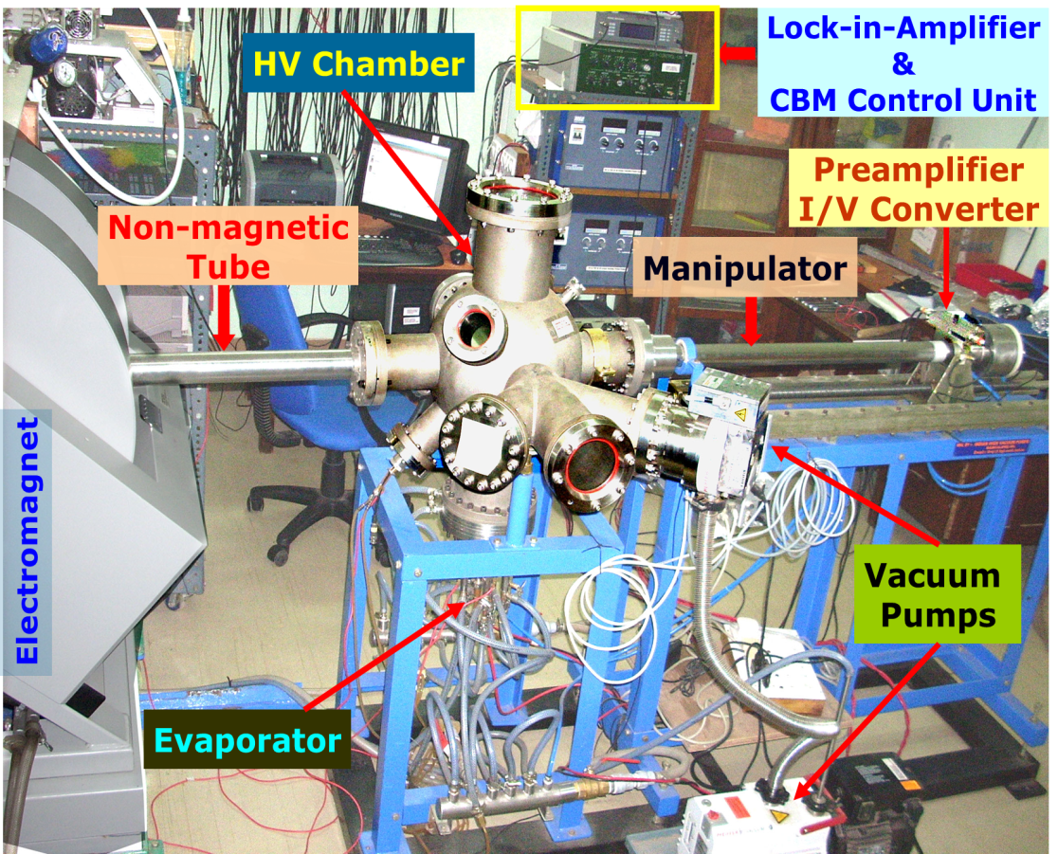
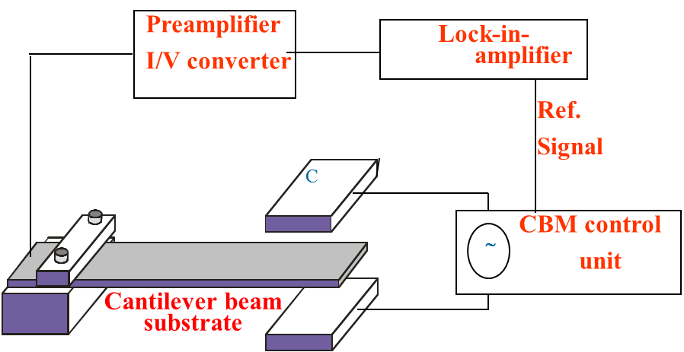
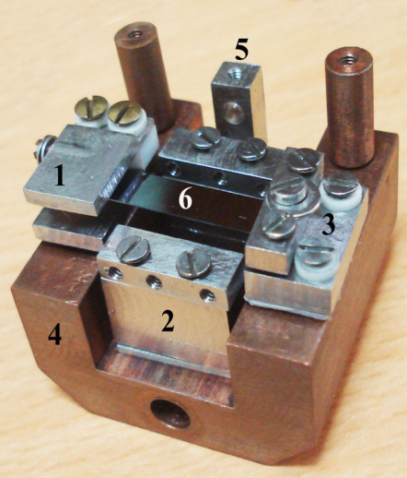
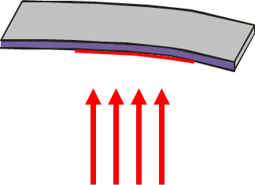
Ph.D. (2012) from Indian Institute of Technology Kharagpur, India.
  Topic : “Development of cantilever beam magnetometer and studies on heterostructure based magnetic diodes”.
  Design, fabrication and automation of high vacuum cantilever beam magnetometer to measure in-situ stress and magnetization in thin films.
  Studies on Spintronics materials: Bulk, nanoparticles, and thin film heterostructures.
B
M(H)
MxB

Slide 3
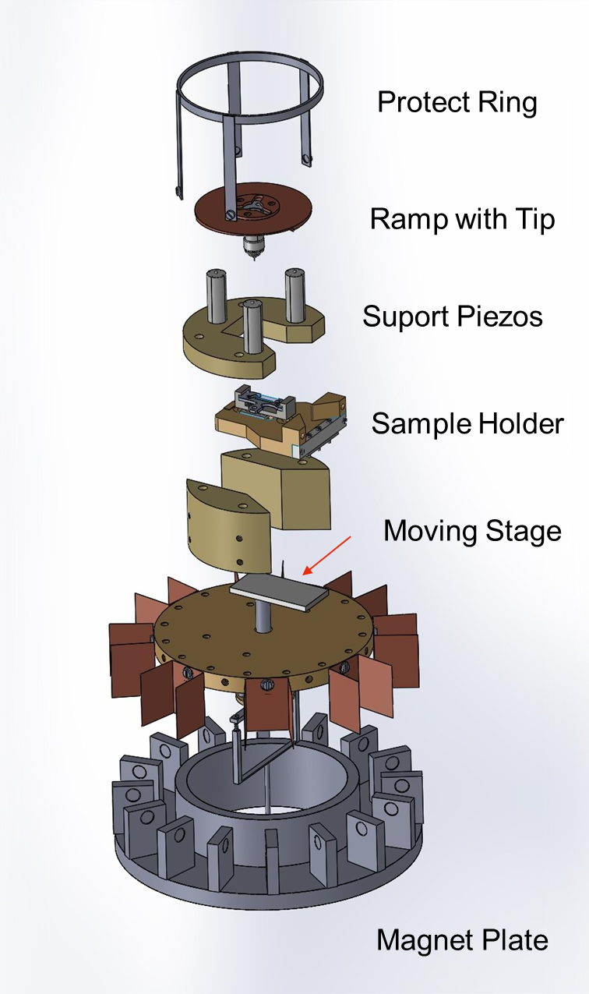
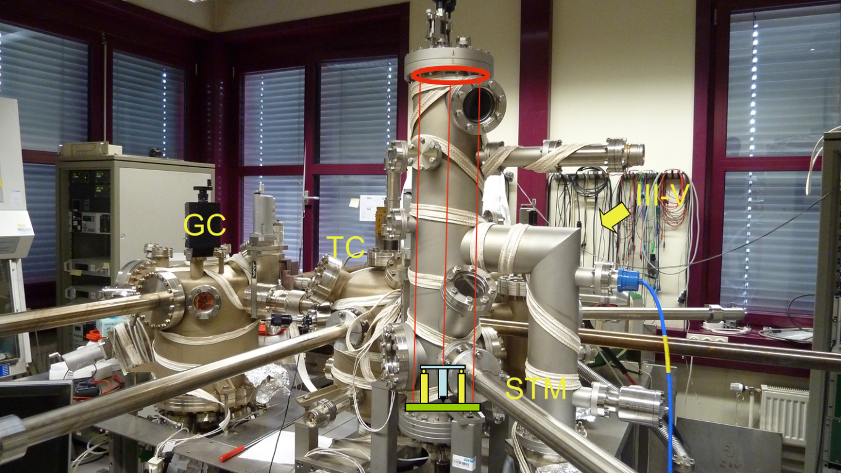
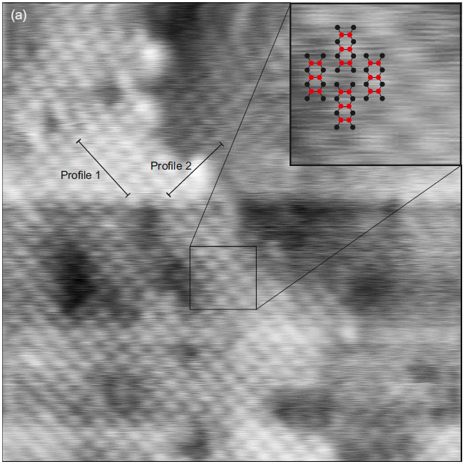
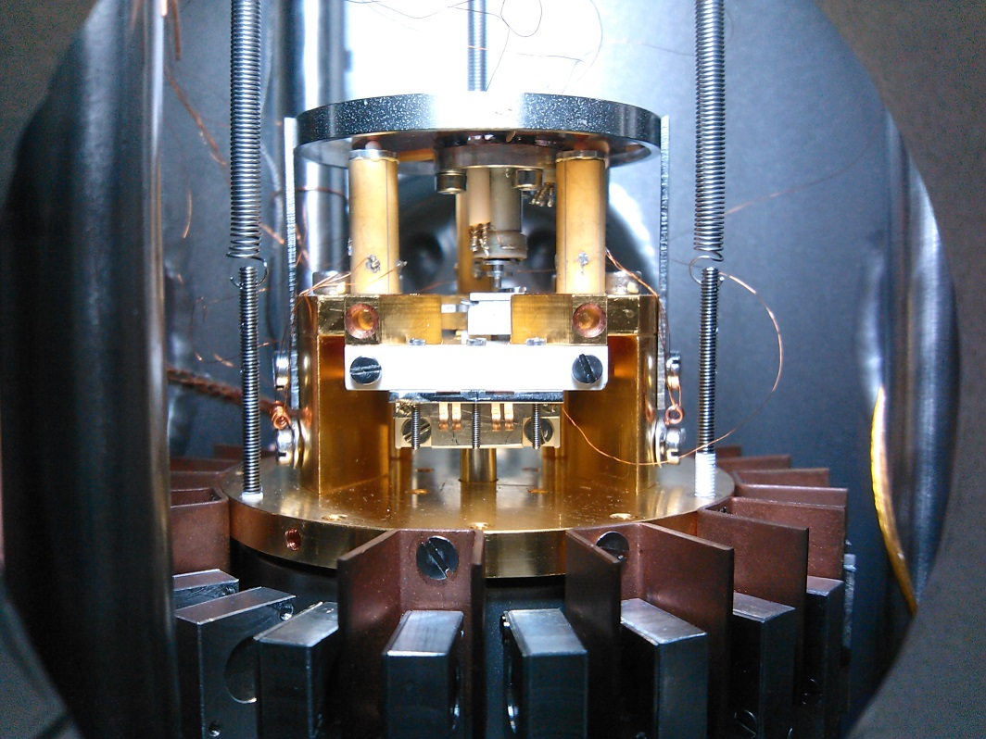
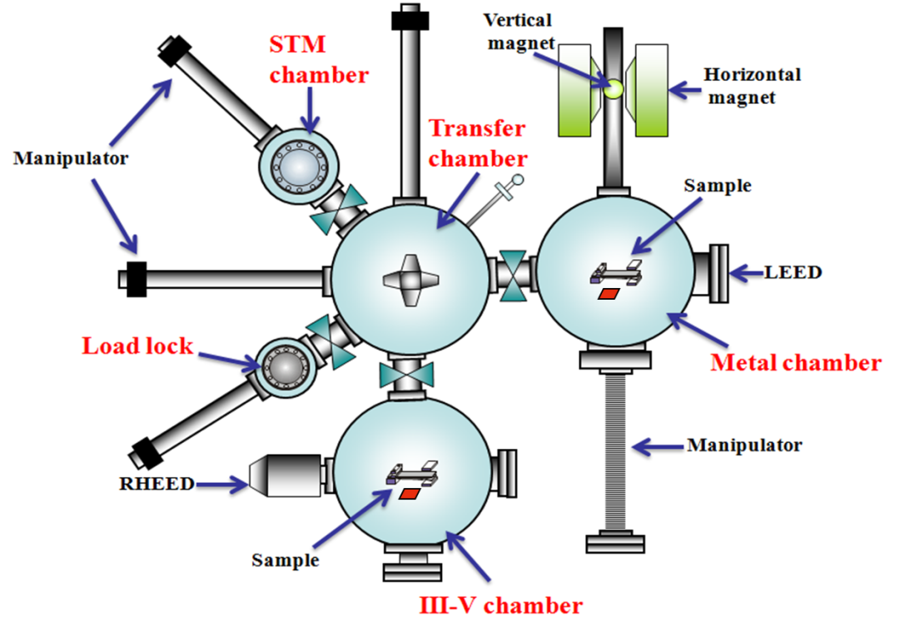
University Assistant (2012-2017) at Johannes Kepler University, Linz, Austria
  Post Doc to Univ. Prof. Dr. Reinhold Koch, Institute for Semiconductor and Solid State Physics.
  Oxide thin film (diffusion/ tunneling) barriers - MgO and MoO₃ between GaAs and 100% spin polarized Half-metallic Heusler alloys.
  TMR (tunneling Magnetoresistance) structures – Co₂FeSi/MgO/Co₂FeSi/MgO/GaAs (Structural, magnetic, and electric transport properties)
  Development of room temperature Scanning Tunneling Microscope (STM) as an extension to the Molecular Beam Epitaxy (MBE) cluster.

Slide 4
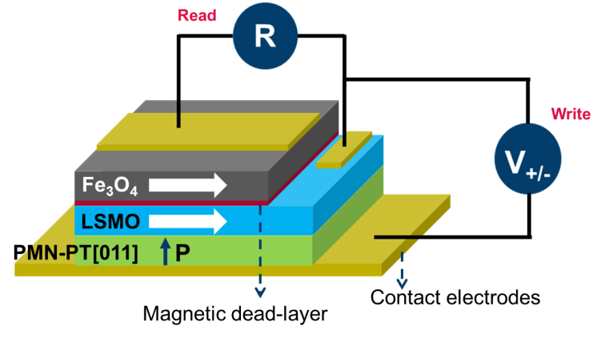
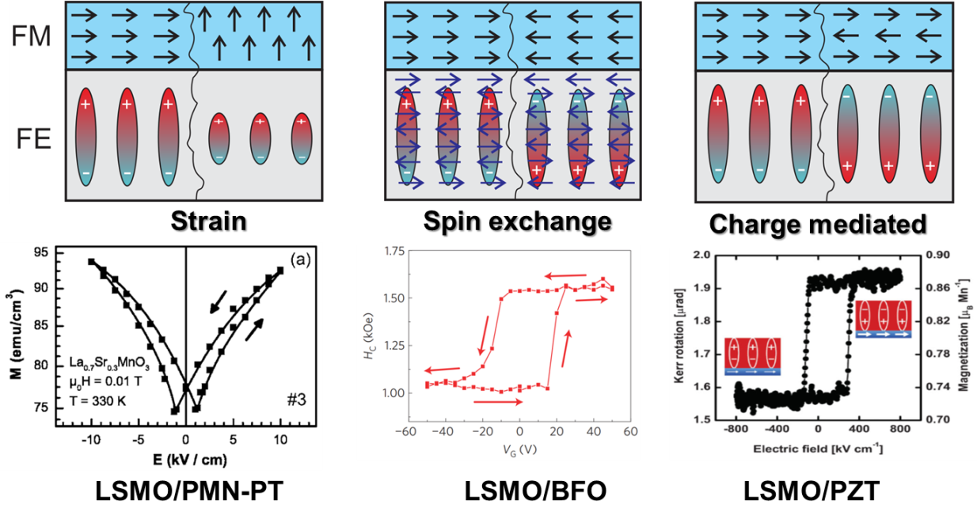
Scientific Staff (2017-2020) at Forschungszentrum Jülich GmbH, Germany.
  Post Doc to Prof. Dr. Thomas Brückel, JCNS2/PGI4.
  Oxide Molecular Beam Epitaxy
  Studying various Interface effects in thin film heterostructure –
    Exchange coupling – Ferromagnet/ Antiferromagnet (e.g. La_{2/3}Sr_{1/3}MnO₃/ La_{1/3}Sr_{2/3}FeO₃)
    Proximity Effects – Ferromagnet/Superconductor (e.g. FePd/Nb)
    Strain-magnetic coupling – Piezoelectric/ferromagnetic (e.g. Piezoelectric/Fe₃O₄ and LSMO)
    Artificial multiferroic heterostructures – Ferromagnetic/ferroelectric (LSMO/BaTiO₃)
Fundamental
Application
Voltage controlled magnetization
Multiferroic-MRAM

