Slide 1
Department für Geo- und Umweltwissenschaften
SEKTION KRISTALLOGRAPHIE
Theresienstraße 41
80333 München
Synthesis of polycrystalline Rb-substituted alumoklyuchevskite (Rb_{3-x}K_{x}Cu₃Al O₂ (SO₄)₄)
C. Scheiblich, N. Reitberger, N. van Well
DGK 2022 16.03.2022

Slide 2
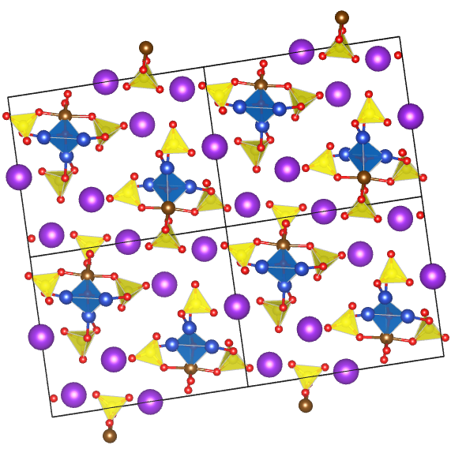
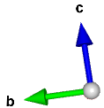
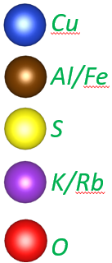
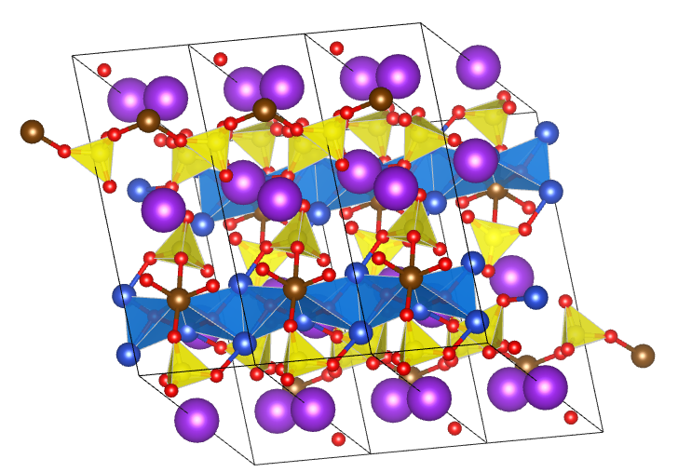
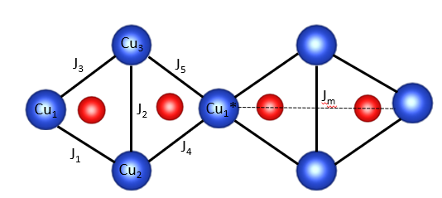
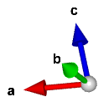
Motivation
Alumoklyuchevskite (K₃Cu₃AlO₂(SO₄)₄) shows an interesting 1-dimensional (1D) magnetic behaviour and is a possible candidate to study spin liquid. Magnetic behaviour arises from copper atoms, which form ½ antiferromagnetic (AFM) chains in a-direction. The chains consists of magnetic monomers and magnetic dimers [1]. For natural minerals, the copper atoms occupy 3 corners of a oxocentered tetrahedron, the fourth corner is occupied by Al and/or Fe. In literature, two structure models with different space groups exist for alumoklyuchevskite [2]. The most recent model P-1 [2] is shown in Figure 1. The other model predicts a crystallization in space group I2 [3]. For synthetically grown alumoklyuchevskite, K can be substituted by Rb or Cs [4]. Such a doping of alumoklyuchevsite leads to different Cu-Cu angles and distances and, therefore, influences the magnetic exchange interaction.
Figure 1: Structure model of alumoklyuchevskite (space group P-1, a = 4.952(3)Å, b = 11.978(6)Å, c = 14.626(12)Å, α = 87.119(9)°, β = 80.25°, γ = 78.07° [2]); a) view along a-axis and b) view in random orientation
Figure 2: Model of magnetic exchange interactions J1,J2,J3,J4,J5 and Jm located in the inequilateral diamond chain of alumoklyuchevskite

Slide 3
Synthesis
Figure 3: a) Polycrystalline KRb₂Cu₃AlO₂(SO₄)₄, retempered in oxygen atmosphere (optical microscope Keyence VHX) b) Back-scattering electron (BSE) image of a KRb₂Cu₃AlO₂(SO₄)₄ phase (Hitachi SU5000 Scanning Electron Microscope); c) Cross-section of a sample, sintered at 600°C in air (green phase – fedotovit, yellow - dolerophanite substrate (optical microscope Keyence VHX)
First synthesis steps by Morita et al. were carried out by tempering a powder mixture [4]. We have used as starting chemicals Rb₂SO₄, CuO, CuSO₄∙5H₂O and AlK(SO₄)₂ 12∙H₂O. To achieve a higher alumoklyuchevskite phase yield, the powder mixture was homogenized and dehydrated. Heating and cooling rates were kept constant throughout all experiments. The varying parameters were the maximum tempering temperature and tempering time. Additionally, some experiments were carried out under different atmospheric conditions. The obtained phases were characterized by optical microscopy, x-ray diffraction and energy dispersive x-ray (EDX) analysis. EDX-results in Table 1 show that different substititions of (3-x)K : xRb are possible.
Sample | O | Al | S | K | Cu | Rb
Rb1K2 | 16,63 | 1,19 | 3,97 | 1,58 | 3,00 | 0,80
Rb1,5K1,5 | 16,07 | 0,92 | 3,57 | 1,37 | 3,00 | 1,25
Rb2K1 | 16,03 | 1,02 | 3,54 | 0,77 | 3,00 | 1,45
Rb3K0 | 16,08 | 0,98 | 3,74 | 0,00 | 3,00 | 2,22
Table 1: Elemental composition of alumoklyuchevskite for different Rb:K ratios. The average of all EDX-spectra is displayed and normalized to three Cu-atoms.

Slide 4
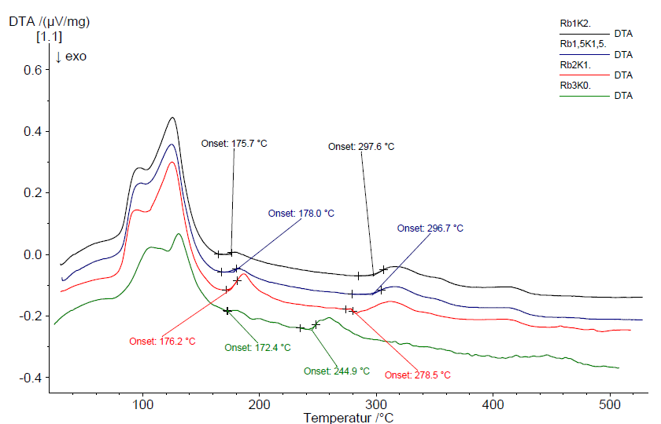
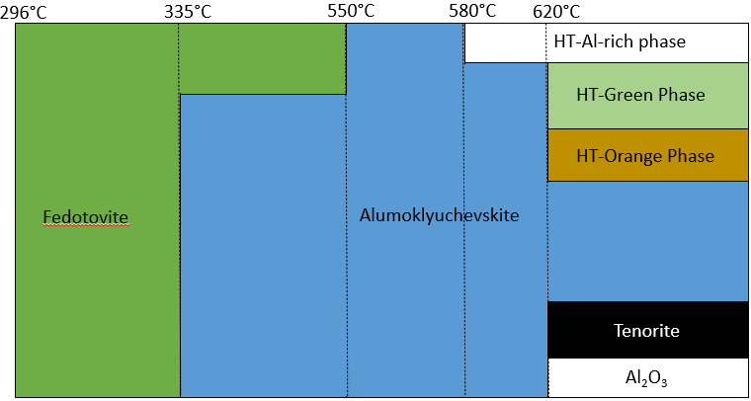
Phase diversity and phase stability
Whereas the synthesis of alumoklyuchevskite occurs between 350°C and 640°C, the optimal conditions for KRb₂Cu₃AlO₂(SO₄)₄ are between 550°C and 580°C. In case of suboptimal conditions, copper sulphate pentahydrate decays into dolerophanite undergoing a possible degassing process releasing SO₃. If the Rb and K diffusion is sufficient, dolerophanite reacts to fedotovite. With an increasing deviation from the optimum stability field, the amount of foreign phases is rising.
Figure 4: DTA heating curves recorded for four different samples with varying RB:K ratios. The curves have been adjusted in their total y-position to provide a better readability of the diagram. Onsets have been set using the first deviation of the curves and the onset tool of the Netzsch Proteus Analysis software.
Figure 5: Schematic representation of phases and the respective stability regions found during synthesis.

Slide 5
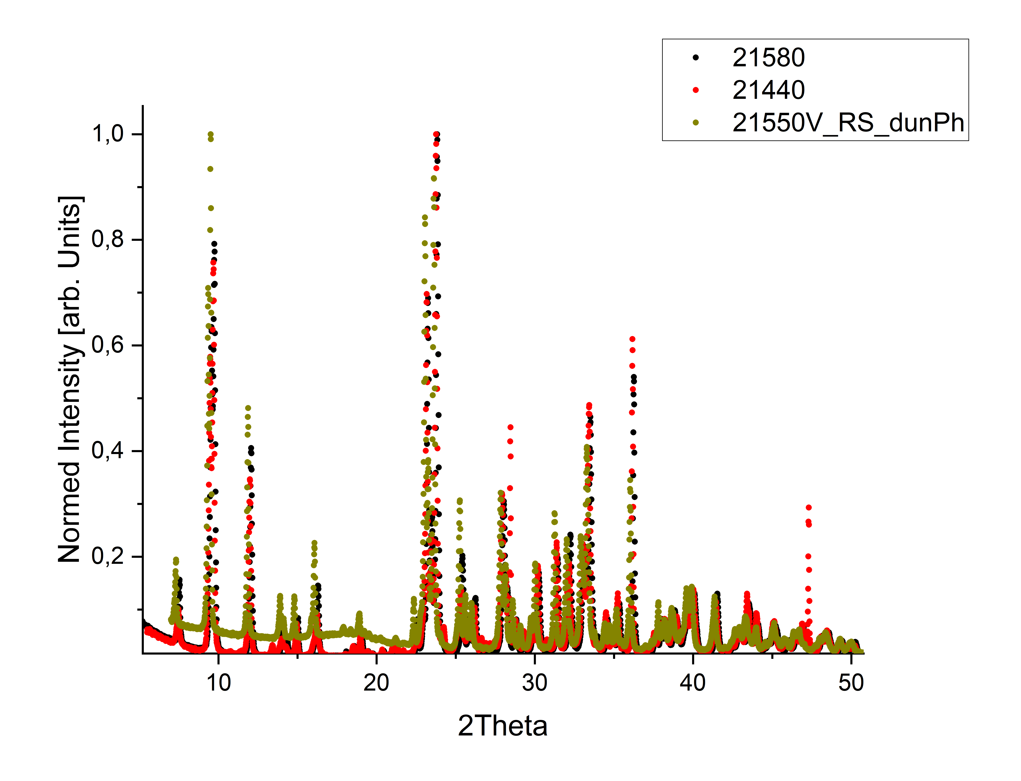
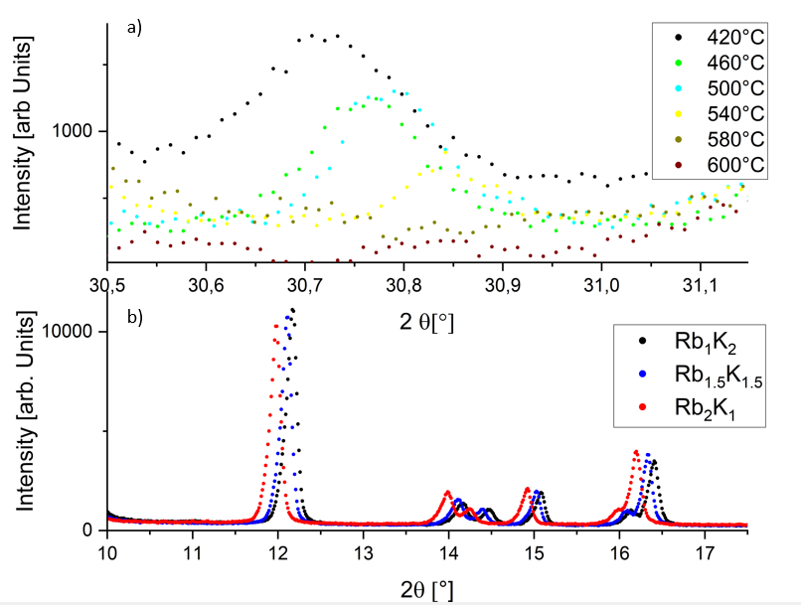
Results from diffraction
Figure 7: Normed diffraction patterns for alumoklyuchevskite tempered at 580°C(sample 21580), 440°C (sample21440) in normal atmosphere and under oxygen atmosphere at 550°C (sample 21550V_RSdunPh). Diffraction patterns were recorded with CuKa1 wavelength.
The aforementioned increase in foreign phases is displayed by the increasing foreign peak intensities in the diffraction patterns in Figure 6a. Figure 4b demonstrates that altering the Rb : K ratio changes lattice parameters but not the crystal symmetry of the structure. Oxygen plays a major role in the synthesis of alumoklyuchevskite. Our samples, tempered under vacuum conditions, showed a decrease of the amount of the alumoklyuchevskite phase, whereas our samples, tempered in an oxygen atmosphere, showed an increase of the alumoklyuchevskite phase. Additionally tempering under optimised conditions influences the peak intensity ratios as it is displayed in Figure 7.
Figure 6: a) Foreign peaks for different tempering temperatures for the 2Rb : 1K ratio; b) Diffraction pattern for different Rb : K ratios; For clarity reasons, only the highlighted regions are shown (Seifert 3003TT, 2θ region between 5° and 85°, Cu-K_{α1} radiation)

Slide 6
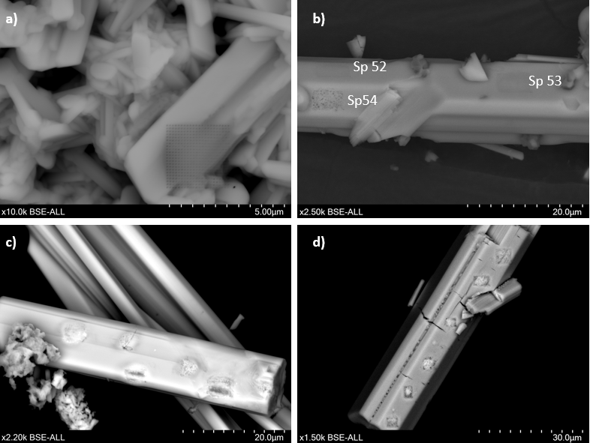
Beam Damage Problematic
Throughout the EDX-measurements a constant depletion in lighter elements could be noticed for samples with unoptimal orientation. This is attributed to beam damage occurring during sampling. The degree of beam damage was higher for samples with a higher Rb/K ratio. This is also displayed in Figures 8 b) to d) where Figure 8d) shows the samples with the highest Rb:K ratio. Comparing Sp54 to Sp53 and Sp52 in Figure 8b) it can be seen that crystal orientation and resulting detector dead times and measurement durations influence the degree of beam damage. The influence of beam damage on “apparent” elemental composition was bigger for the high temperature green phase compared to alumoklyuchevskite but the same trends could be found for both phases.
Figure 8: a) SEM-image of beam damage on blue phase of alumoklyuchevskite b) SEM-image of beam damage on Rb:K 1:2 high temperature green phase c) SEM-image of beam damage on Rb:K 2:1 high temperature green phase d) SEM-image of beam damage on Rb:K 3:0 high temperature green phase

Slide 7
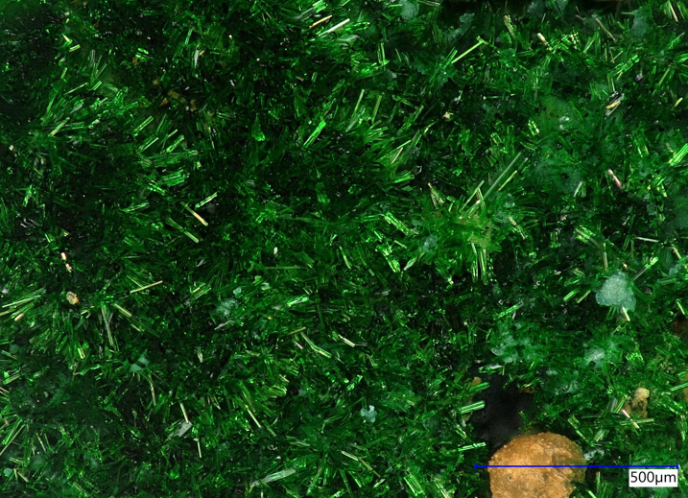
Magnetic Results and Outlook
Outlook
The susceptibility measurements was performed between 2.7K and 280K and a magnetic field between 0.1T and 7T. Figure 9 shows first results for undoped and Rb-doped compositions. Whereas the broader peaks at high temperatures remain unchanged, such at lower temperatures change due to altering the Rb : K ratio. These results indicate a change in the magnetic interaction between the Cu-atoms.
To realise the growth of single crystals, the growth via gas transport method will be performed. Additionally, further susceptibility measurements will be performed with different Rb : K ratios. Fruther investigations with EDX would be needed to correct for errors induced by beam damage.
Figure 10: Fedotovite crystals grown on top of samples that were tempered at 640°C (optical microscope Keyence VHX)
Literature
[1]: M. Fujihala, H. Koorikawa, S. Mitsuda, K. Morita, T. Tohyama, K. Tomiyasu, A.Koda, H. Okabe, S. Itoh, T. Yokoo, S. Ibuka, M. Tadokoro, M. Itoh, H. Sagayama,R. Kumai und Y. Murakami, Possible Tomanga-Luttinger spin liquid state in the spin-1/2 ineqilateral diamond chain compound K3Cu3AlO2(SO4)4, www.nature.com, Scientific Reports, 2017
[2]: O.I. Siidra, E.V. Nazarchuk, A.N. Zaitsev, E. A. Lukina, E.Y. Avdontseva, L.P.Vergasova, N.S. Valsenko, S.K. Filatov, R. Turner und G.A. Karpov, Copperoxosulphates from fumaroles of Tolbachik volcano: puninite, Na2Cu3O(SO4)3 – a new mineral species and structure refinements of kamchatkite and alumoklyuchevskite, www.geoscienceworld.org, 2017
[3]: M.G. Gorskaya, L.P. Vergasova, S.K. Filatov, D.V. Rolich, V.V. Ananiev, Alumoklyuchevskite K3Cu3AlO2(SO4)4, a new oxosulphate of K, Cu and Al from Volcanic Exhalations, Kamchatka, Russia, 1995
[4]: K.Morita, M. Fujihala, H. Koorikawa, T. Sugimoto, S.Sota, S. Mitsuda, T. Tohyama, Static and Dynamic Magnetic Properties of spin-1/2 Inequilateral Diamand-Chain Compounds A3Cu3AlO2 ( A= K,Rb and Cs), Phys. Rev. B 95, 184412, 2017
Figure 9: Susceptibility measurements at 0.1T and 1T in zero field cooling (Oxford Maglab VSM); The red and green curve are K-bearing alumoklyuchevskite samples and the blue curve is from a Rb-doped alumoklyuchevskite

