Slide 1

Polarized Backscattering with high Resolution
E. Babcock, M. Zamponi, S. Mattauch
@

Slide 2
History / back-story for polarized QENS
Wide angle inelastic PA, SM based, DNS and D7
  Direct geometry and compact, resolution limited to about 100 μeV
PASTIS, ³He based (but uniaxial) also on direct geometry gives a taste of polarized QENS
  LET @ ISIS experiments on D₂O (published) max resolution 22 μeV
  NEAT @ HZB with JCNS exp. on H₂O (in process) max resolution 50 μeV, but lower Q_{min}
These experiments raise interest for QENS measurements with PA
  e.g SHERPA workshop at ISIS, inverted geometry for pulsed sources, proposed resolutions >10 μeV
Many projects and proposals for PA with >10 μeV resolution
Power of continuous source backscattering is resolution of 1 μeV or better
MORIS project may enable us to work on an instrument with UNIQUE properties utilizing the strengths of the FRM2 source

Slide 3
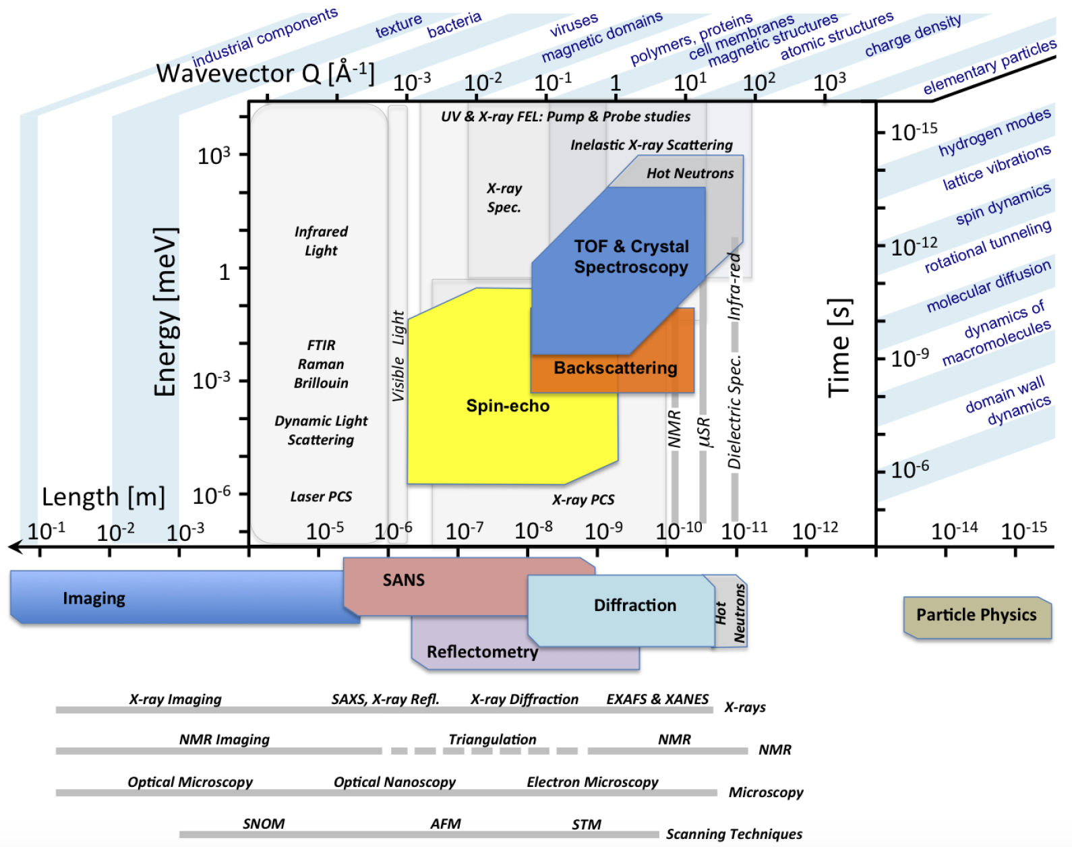
Usual Chart of applications (from ESS webpage)

Slide 4
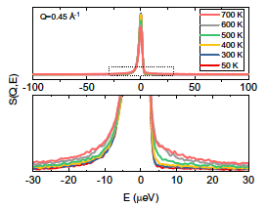
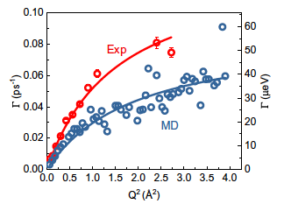
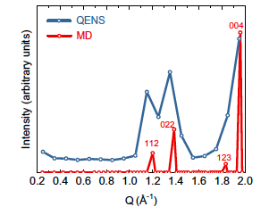
Scientific case
Polarized Backscattering with high Resolution
Measurement of incoherent QENS in presence of coherent
Coherent scattering is often concentrated in certain Q ranges
(Bragg peak, amorphous halo, SANS), making these inaccessible
Li- self-diffusion in Li garnet oxide @ BASIS
700K
Klenk et al., Solid State Ionics 312, 1 (2017)

Slide 5
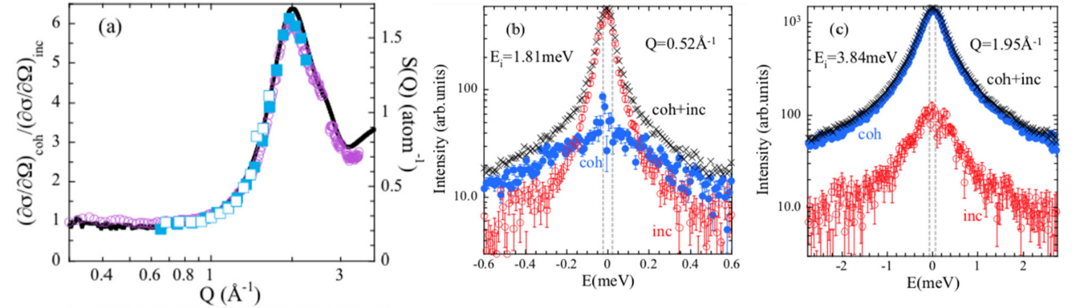
Scientific case PBR cont.
Measurement of coherent QENS in presence of incoherent
Incoherent scattering often dominant despite high degree of deuteration
- Typical H/C ratio in an organic material is 2/1. With 95% deuteration this
gives still 42% incoherent scattering
Heavy water @ LET
Arbe et al., Physical Review Research 2, 022015 (2020)

Slide 6
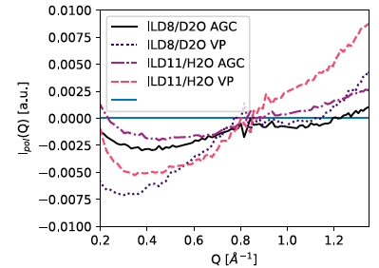
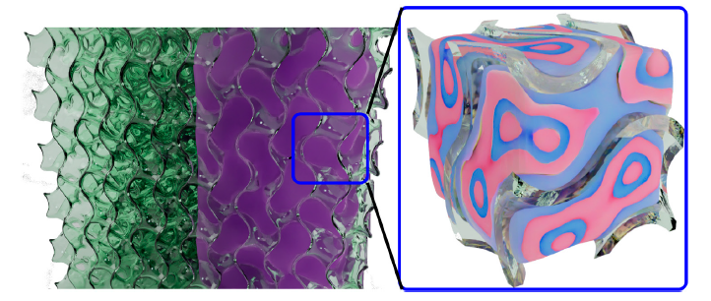
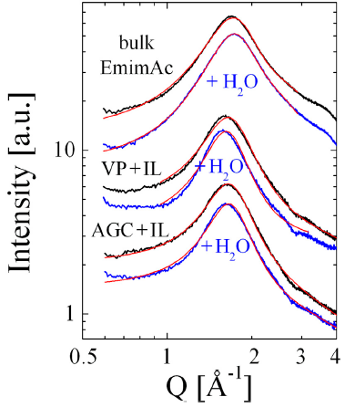
Scientific case PBR cont.
Measurement of coherent and incoherent QENS on same sample
Could be done on one sample if:
- coherent and incoherent scattering can be separated
- nanosecond timescale can be reached (equivalent µeV resolution)
Confined ionic liquid-water mixtures @ WASP
polarized intensity
incoherent coherent
scattering dominating
Frielinghaus et al., Front. Phys. 10, 872616 (2022)

Slide 7
Scientific case PBR cont.
PA-QENS a current scientific ‘hot topic’ however:
Current proposals do not consider resolution <10µeV
=>Therefore complementary science case for sub-µeV PA

Slide 8
The laws of applying polarization
Do no harm to the unpolarized instrument
Only apply PA when there is a strong theroretical or experimental justification
Steady polarization, polarization as an instrument component, is best but don‘t forget law 1 (or 2)

Slide 9
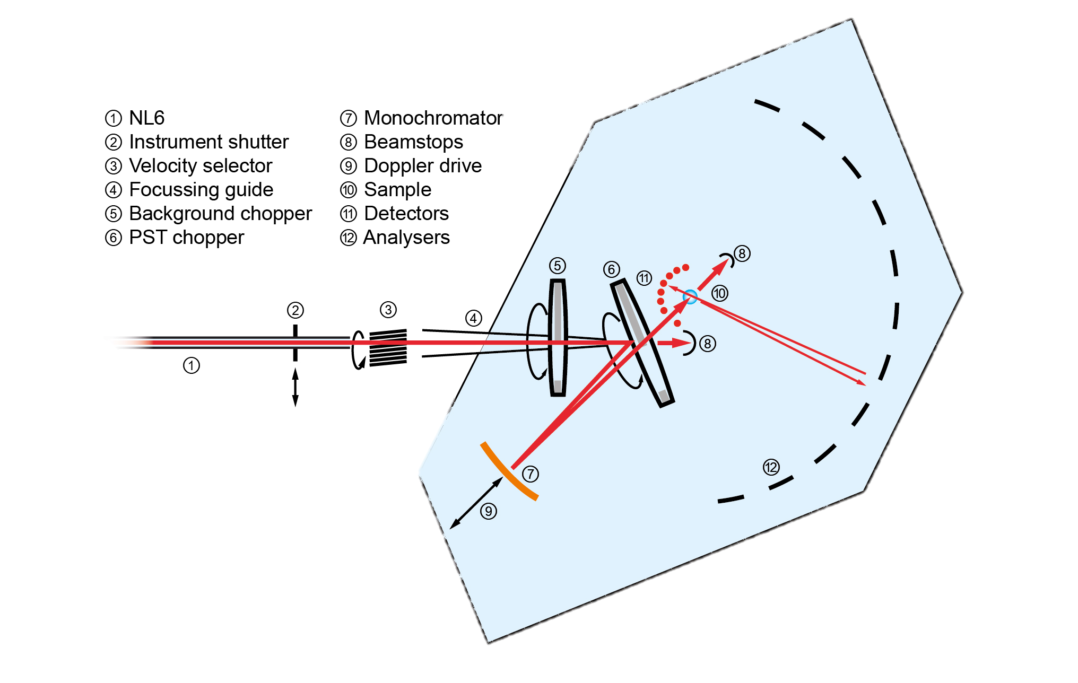
Where can Polarization components go?
For traditional backscattering the beam is focused back trough the sample, angular divergence for SM solutions is the usual
  Θ=W/2d
³He solutions are „divergence independent“, However have limitations of needing to be actively polarized/or exchanged regularly, need to be close to the SE
Any solution will need a magnetic guide field over the entire analyzer tank
Polarization Analyzer

Slide 10
Guide field
Simply add a large
Helmholtz coil
At 2.5m=R need 2800A/turns for a coil pair for 10gauss
200 turns at 14 A with 3mm wire
  3.2 kW, ~45 euro/day
  about a 5x5cm coil,
  590 kg copper
Would also provide the magnetic enviroment for ³He
Field would be constant: no time changing influence on other instruments

Slide 11
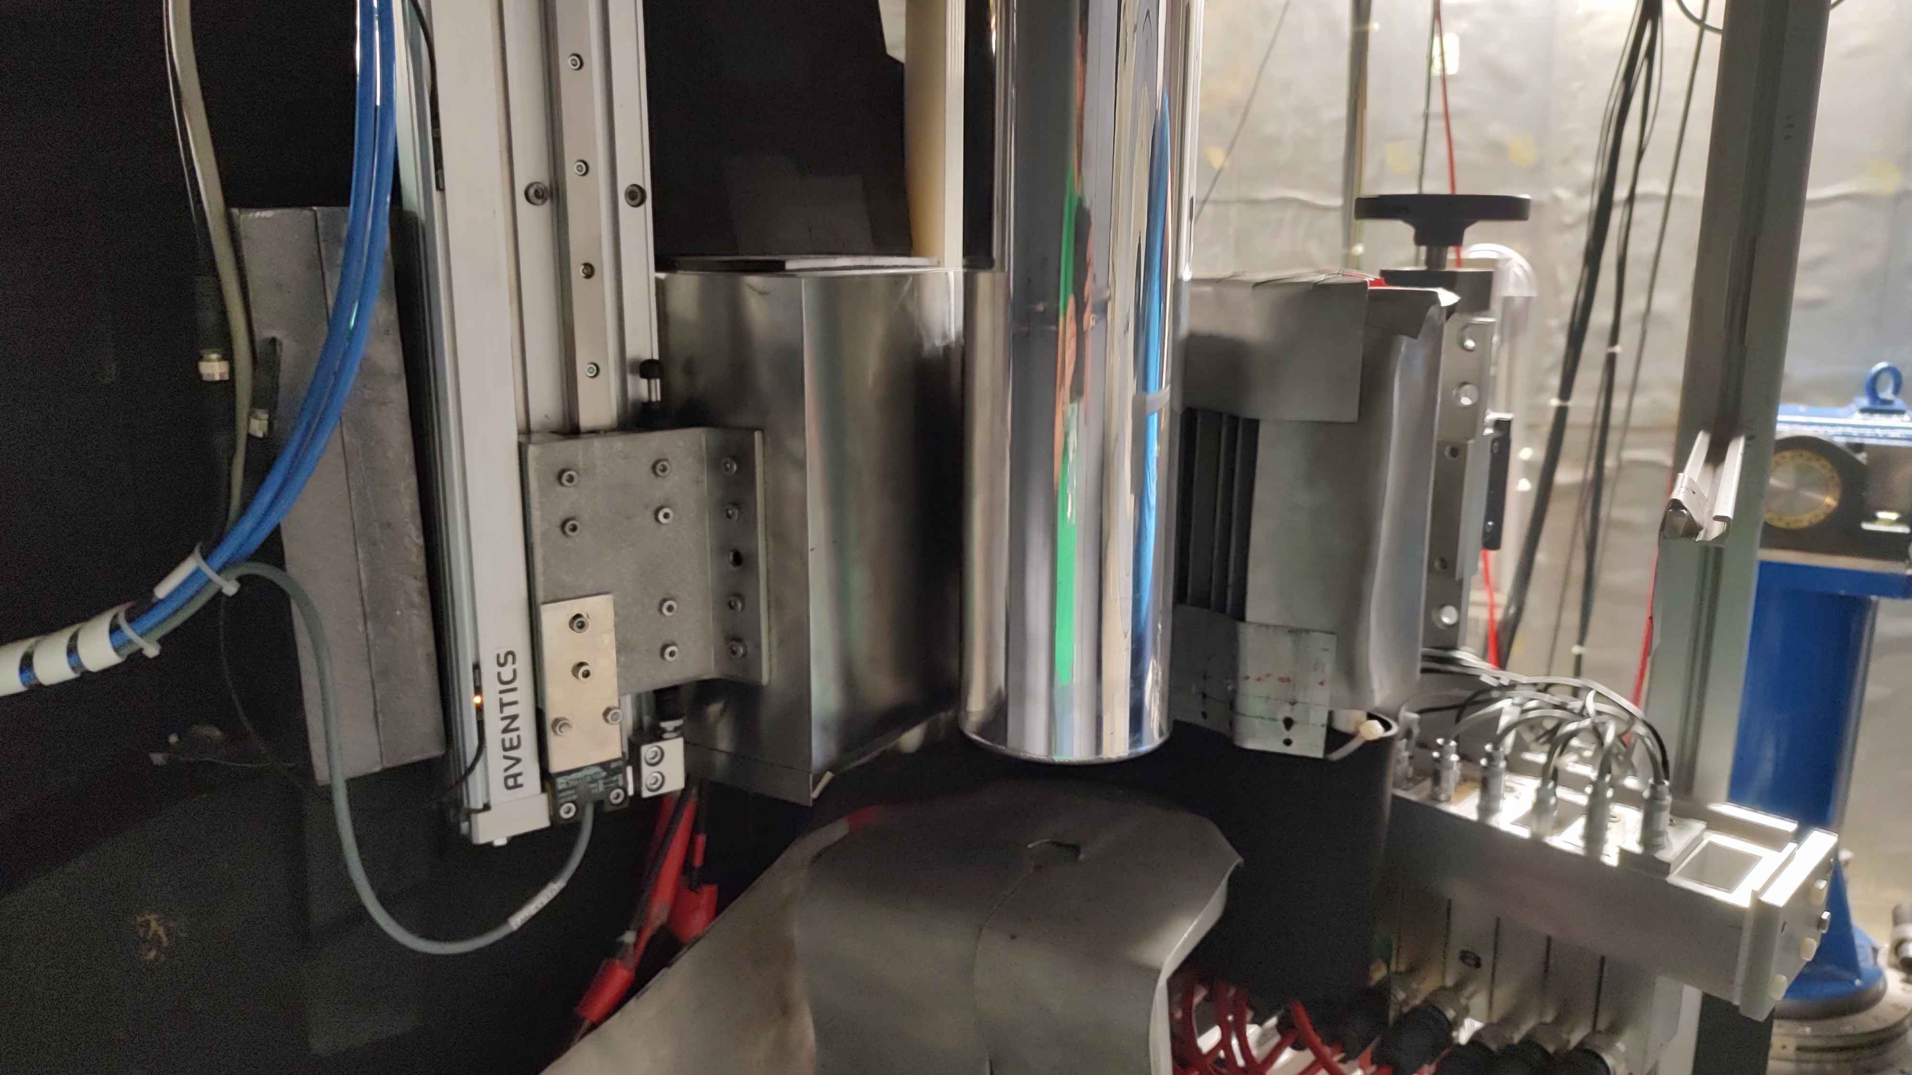
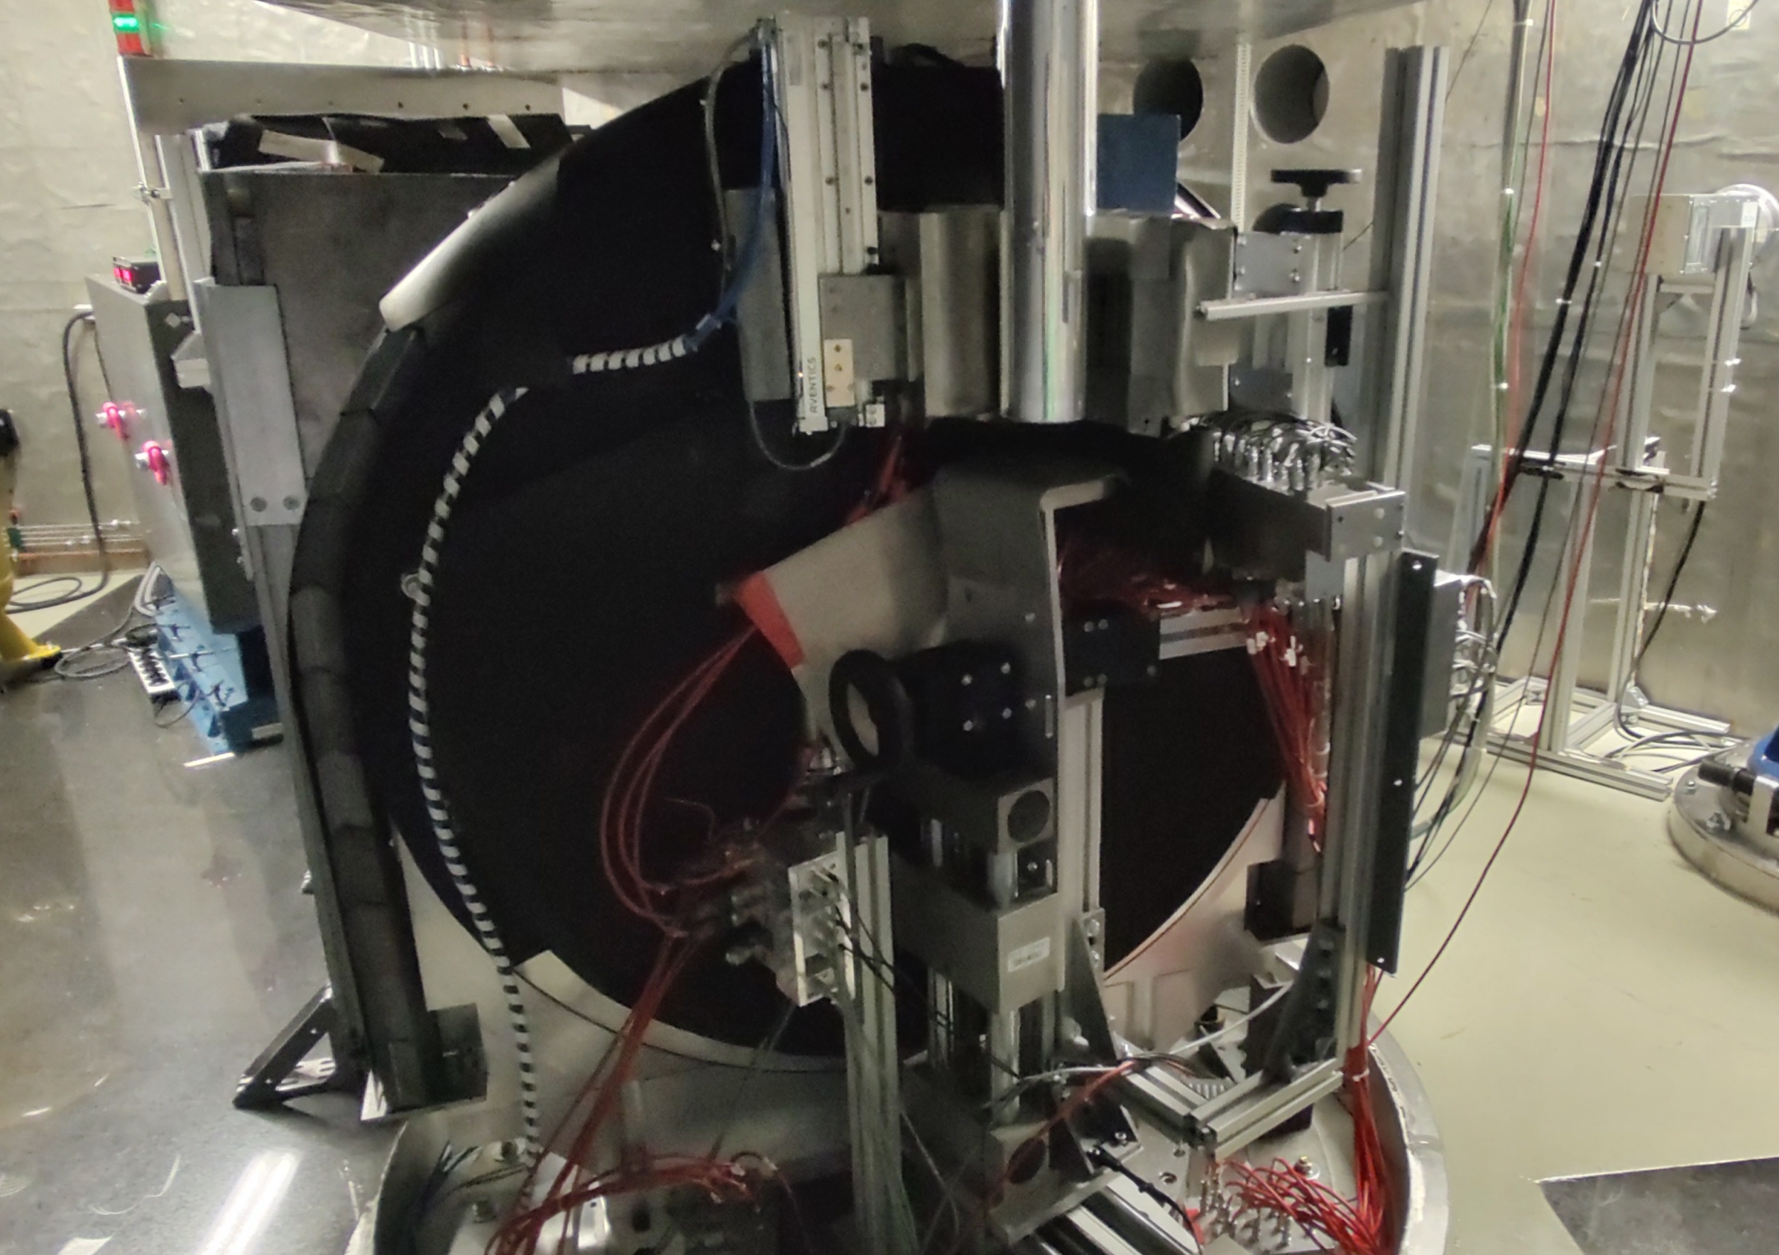
SPHERES

Slide 12
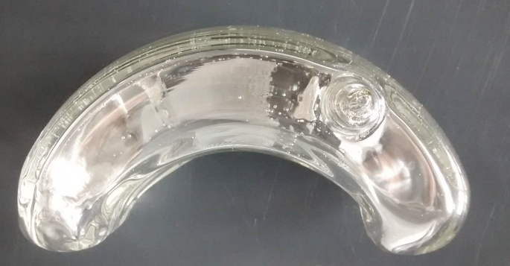
³He analyzer option
Active polarization
  In-situ ----steady
  Ex-situ---- decaying
T_{n}=30% at P_{n}=94% (in-situ)
In principle large angular coverage
and any sample size
Q_{min}>0.5 Å⁻¹ from cell geometry
and position
Fundamental limit from geometry
Small angle detectors are out of backscatering geometry, could be covered with a second cell(s)
Pastis1 cell
6 bar cm
OD=16cm
ID=8cm
Beam
Second cell
Radial collimator starts at r=8cm, small angle detectors also very close
Ex-situ polarization would require separation of the Ar flight path
In-situ polarization requires thermal management, but possible in Ar or vacuum

Slide 13
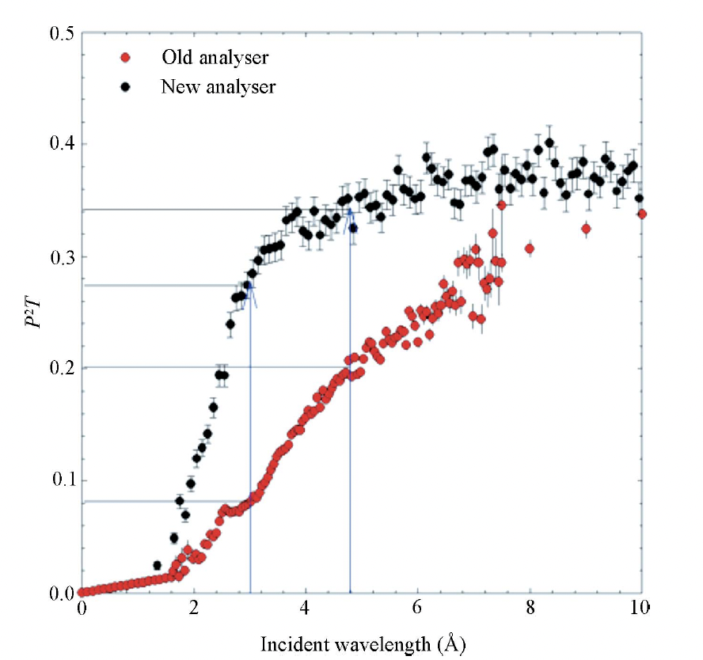
Traditional reflection SM analyzer option
Make extrapolations based on the
“new” D7 analyzers:
J.R. Stewart et al., J. Appl. Cryst. 42,
69 (2009).
6.27Å and W=30mm at 625mm+250mm
to detectors, which are 250mm high
20mm sample d becomes 416.6mm, detectors at 666.6mm
current SPHERES has about 53°vertical
SM at 875mm would have 16°
at 666.6mm about 21°
double the height, i.e 2x250mm then >42°vertical
Simply NO space in the current configuration
λ_{min}=3.1Å, d=1250mm, W=30mm

Slide 14
What about after the sample, i.e. between sample and Si analysers?
Neutrons pass the polarization analyzer twice
Diffraction background of ³He cell requires a collimator?
SM transmission analyser + integrated collimator
inelastic effects on neutron energy at 𝞵eV level?
Collimation (if needed) could be problematic for SANS detectors

Slide 15
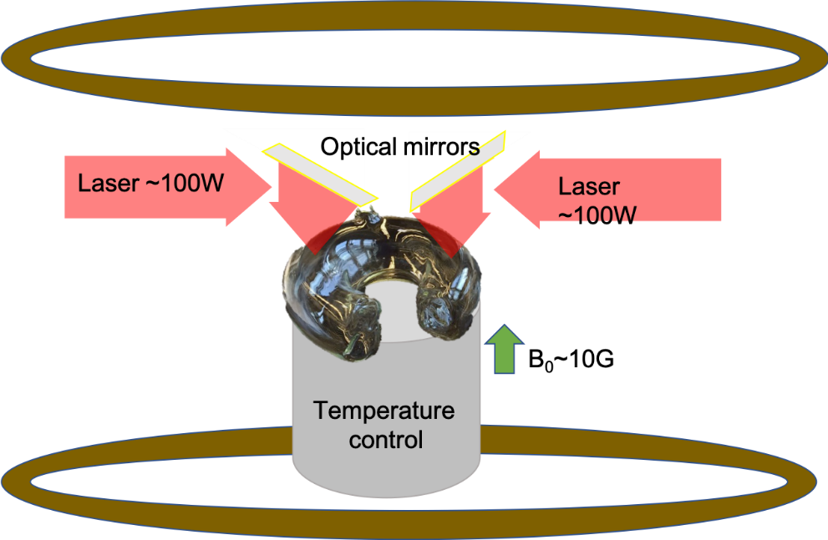
In-situ polarization?
Ar flight path on SPHERES
  Cell exchange would be difficult
  For in-situ polarization 100‘s of watts
  are provided by the optical pumping lasers
  Laser power and heat loss to radiation are comparable at SEOP conditions
  (180 ˚C)
Will a collimator be required because
of the cell?

Slide 16
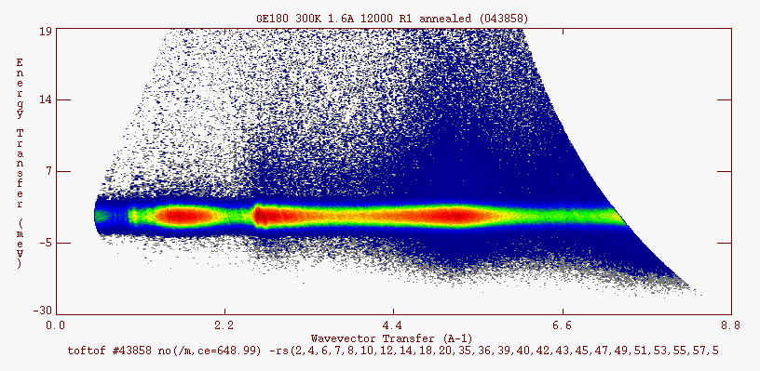
Does GE180 affect (energy) resolution
Spectrum measurements on TOFTOF (G. Simeoni)

Slide 17

„WAPA“ Transmission SM analyser
In principle double pass should also be possible
Similar divergence consideration as
reflection analyzer
  Array at d=416 mm for a 20 mm sample,
  >500mm high
Again, Collimation could be problematic for
SANS detectors
=> Here it is intrinsic
P. Böni et al., Nuclear Inst. and Methods in Physics Research A 966, 163858 (2020)

Slide 18
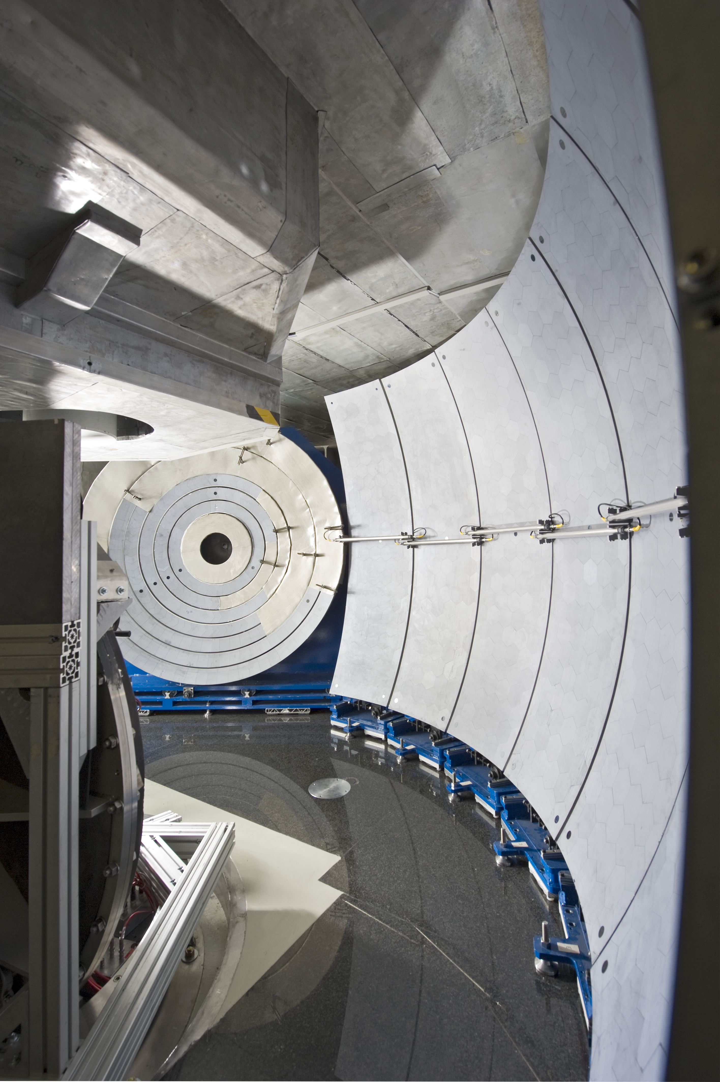
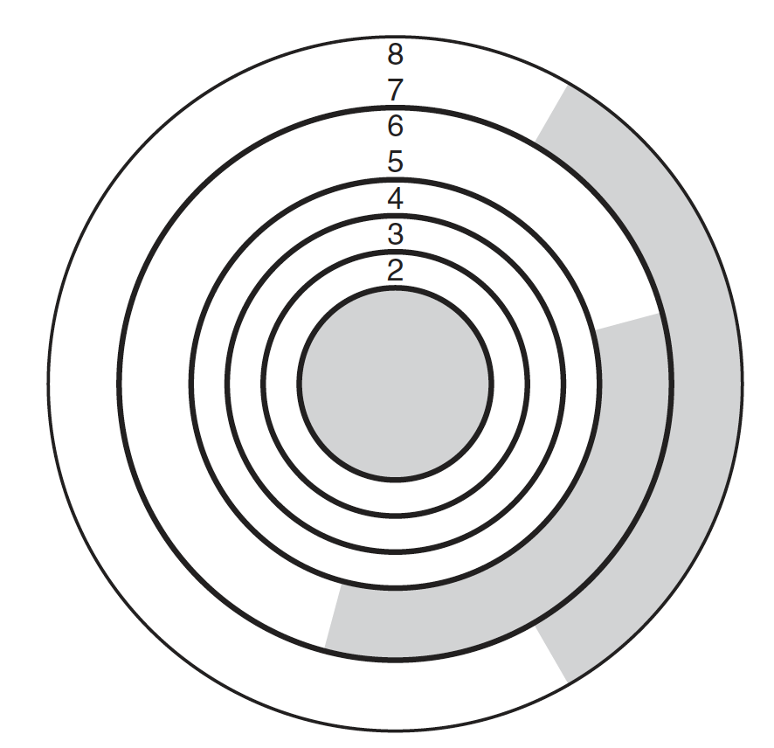
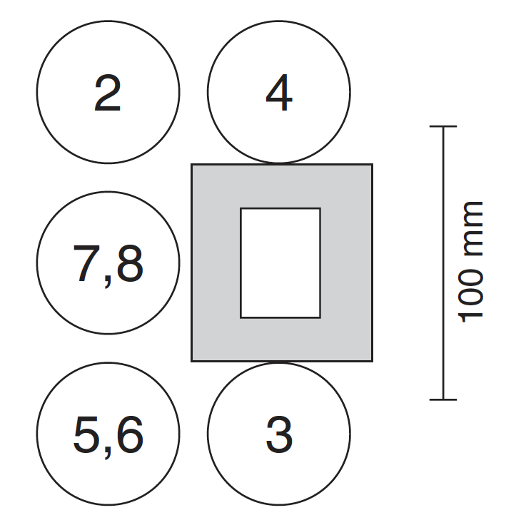
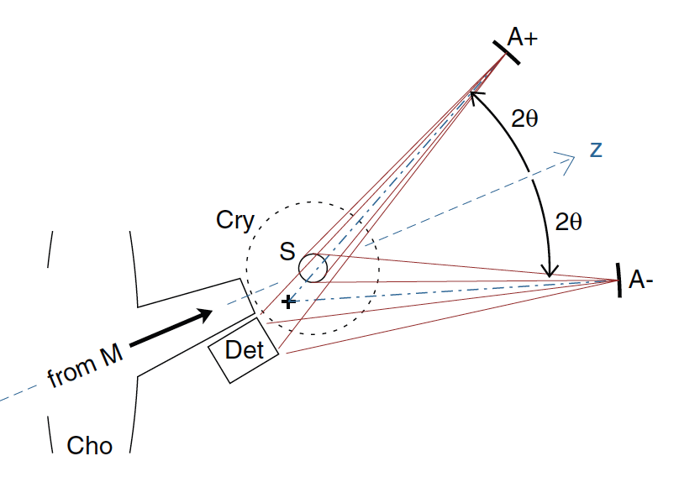
Small angle analyzers and detectors Q<0.5Å
J. Wuttke, M. Zamponi, Rev. Sci. Instrum. 84, 115108 (2013)

Slide 19
Expected performance SM or ³He
Either SM or ³He could provide T_{n}>20% and P_{n}>95%
Given 2/3 spin flip for incoherent scattering one would expect
I_{incoh}≈15% of the unpolarized instrument
Coherent scattering I_{coh}≈20% (minus 1/2*I_{incoh})
Flipping ratios F>25 assuming incident polarization >97%
Roughly 5x less counts but 25x higher S/N (contrast) before PA corrections
=> Would PA cause a significant change in measurement time for
„standard“ measurments?
With PA the „extra“ measurement separates coherent and incoherent contributions

Slide 20
Common challenges
Guide field
Incident beam polarization and flipper
Sample to detector distance
To be made removable
Both capable of “full“ analyzer coverage with work
Key differences
SM would limit sample width to maintain polarization performance
Collimation intrinsic for transmission SM
In-situ 3He polarization a must / active system

Slide 21
Summary
Good scientific motivation for an instrument with UNIQUE capability
Major components technically feasible but a challenge to
fit into existing instrument
Detailed study simulation + testing required to compare
SM and ³He

Slide 22
acknowledgements
Reiner Zorn
Jörg Voigt
Olaf Holderer
Klaus Lieutenant
Margarita Russina (HZB)

Slide 23
Thank you
for your
attention!

