Slide 1




ICONE
TDR results
https://www.icone-neutron.fr/
Nicolas Pichoff
26/11/2025 – MLZ/LLB workshop – ICONE TDR results

Slide 2
ICONE Project main goal
Deliver a national facility for about ~300 experiments/year
→ 12 instruments : According to scientific case
→ 2 neutron sources : High Flux (HF) : ~2 ms@20Hz (4% DC)
High Resolution (HR) : ~400 µs@50Hz (2% DC)
→ 1 proton accelerator : 25 MeV, 80 mA @ 8% of Duty Cycle (DC)
Project requirements (end of 2023) :
Results presented here
→ TDR 2024-2025 → Construction plan consolidation
If GO<2026
→ Phase 1 : First neutrons & instruments in 2033 (2034, for users)
If GO<~2032
→ Phase 2 : Full capability in 2037
2
26/11/2025 – MLZ/LLB workshop – ICONE TDR results

Slide 3

Organisation
Control Committee (CEA, CNRS, MESR)
Steering Committee (CEA, CNRS)
Academic, Industrial and society goals
Project leading (Budget, Schedule, risks…)
WP1: PROJET MANAGEMENT
Scientific Advisory Board
SO
A. Desmedt (CNRS)
PL
N. Pichoff (CEA)
Resource Committee
PMO
T. Vassiliadès (CNRS)
WP2: INSTRUMENTS
X. Fabrèges (CNRS)
WP3: TMR Sets
F. Ott (CEA)
WP4: LINAC
D. Uriot (CEA)
WP5: INFRASTRUCTURE
A. Ferland (CEA)
Neutron use
Neutron production
Proton production
Infrastructure hosting
3
26/11/2025 – MLZ/LLB workshop – ICONE TDR results

Slide 4
Global view (→ 2037)
77 m
- Accelerator p⁺, 80 mA, 25 MeV @ 8%DC
Zone 7
1 m²
Zone 4
29 m
Zone 5
24 m
Zone 6
21 m
Zone 9
- Neutron Peak Brilliance :
~ 5 10¹¹ /s/cm²/sr/Å @ 1 Å et 2.5 Å
~ 10¹¹ /s/cm²/sr/Å @ 5 Å
Zone 3
33 m
Zone 4
Zone 2
31 m
Zone 5
Zone 5
Zone 5
Zone 2
Zone 5
Zone 5
Zone 4
Technical area
22×21 m²
Zone 2
Zone 3
Zone 1
30 m
1 m²
Zone 3
Zone 5
Zone 5
Zone 1
Zone 5
Zone 1
Office area
43×21,5 m²
- Target 1 : 0.4 ms@50 Hz (2% DC)
Zone 7
Zone 9
- 6 instruments HR (<44 m)
Zone 4
445m
Zone 5
36 m
Zone 6
31 m
65 m
1 m²
- Target 2 : 2.0 ms@20 Hz (4% DC)
Zone 3
44 m
Zone 1
Zone 3
Zone 1
Zone 4
Zone 2
- 6 instruments HF (<33 m)
Zone 2
41 m
RFQ-4.6m (3.6 MeV)
XDTL-5.5m (12 MeV)
XDTL-8m (40 MeV)
Zone 3
350 cm
Zone 2
315 cm
SRC+LEBT-3.5m (0.75 MeV)
XDTL-7m (25 MeV)
350 cm
MEBT-2.2m (3.6 MeV)
Zone 4
LINAC-31m (40 MeV)
Zone 1
40 m
- Staff buildings :
- Technical area (~1000 m²)
- Office area (~1500 m²)
Reception
5×5 m²
1:500
1 cm = 5 m
4
26/11/2025 – MLZ/LLB workshop – ICONE TDR results

Slide 5
Phase 1 (→ 2034)
- Accelerator p⁺, 80 mA, 25 MeV @ 8%DC
- Neutron Peak Brilliance :
~ 5 10¹¹ /s/cm²/sr/Å @ 1 Å et 2.5 Å
~ 10¹¹ /s/cm²/sr/Å @ 5 Å
Zone 4
Zone 5
Zone 5
Zone 5
Technical area
22×21 m²
Zone 2
1 m²
Zone 3
Zone 5
Zone 1
- Target 1 : 0.4 ms@50 Hz (2% DC)
Zone 7
Zone 9
- 3 instruments HR (<44 m)
Zone 4
445m
Zone 5
36 m
Zone 6
31 m
1 m²
- Target 2 : 2.0 ms@20 Hz (4% DC)
Zone 3
44 m
Zone 1
Zone 3
Zone 1
Zone 4
Zone 2
- 3 instruments HF (<33 m)
Zone 2
41 m
RFQ-4.6m (3.6 MeV)
XDTL-5.5m (12 MeV)
XDTL-8m (40 MeV)
Zone 3
350 cm
SRC+LEBT-3.5m (0.75 MeV)
Zone 2
XDTL-7m (25 MeV)
315 cm
350 cm
MEBT-2.2m (3.6 MeV)
Zone 4
LINAC-31m (40 MeV)
Zone 1
40 m
- Staff buildings :
- Technical area (~600 m²)
- Office area (~1500 m²)
Reception
5×5 m²
1:500
1 cm = 5 m
5
26/11/2025 – MLZ/LLB workshop – ICONE TDR results

Slide 6
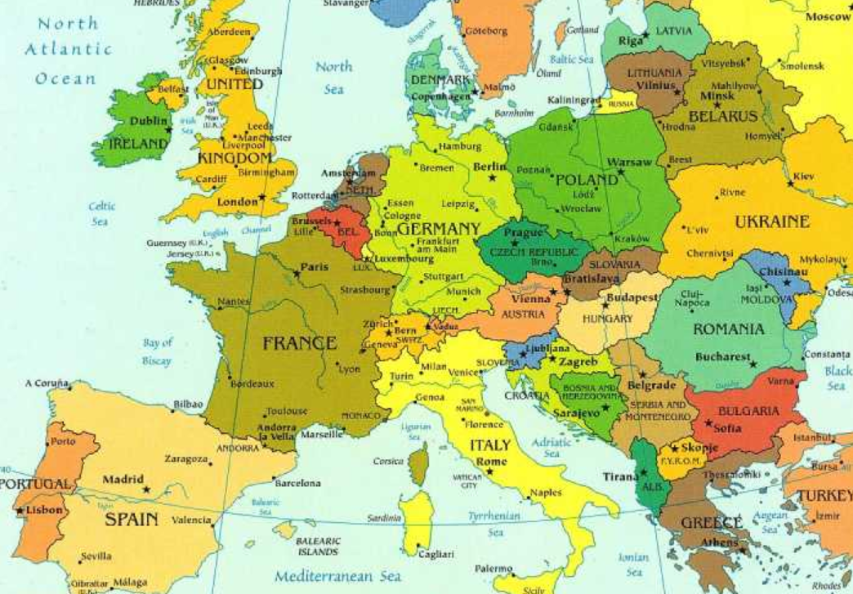
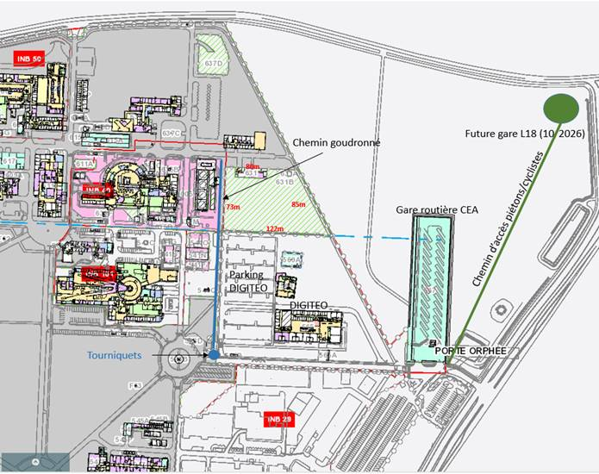
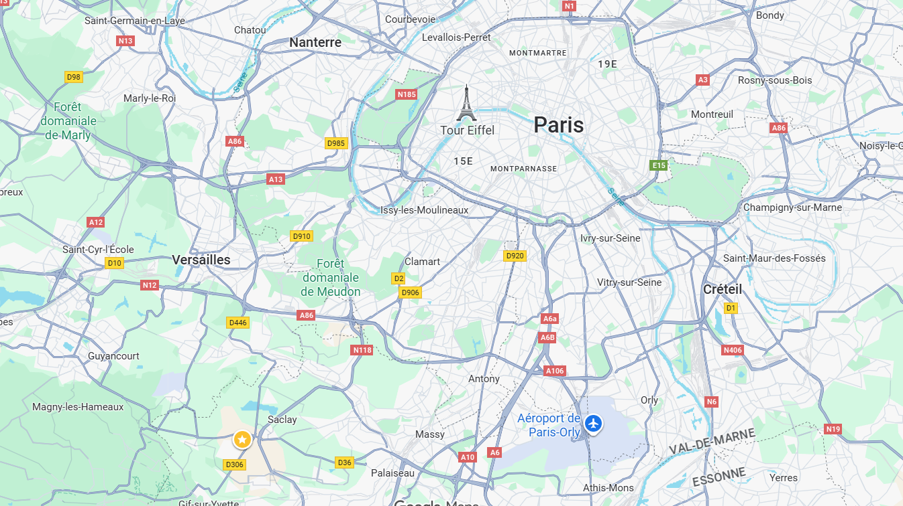
Position
Saclay CEA center
6
26/11/2025 – MLZ/LLB workshop – ICONE TDR results

Slide 7
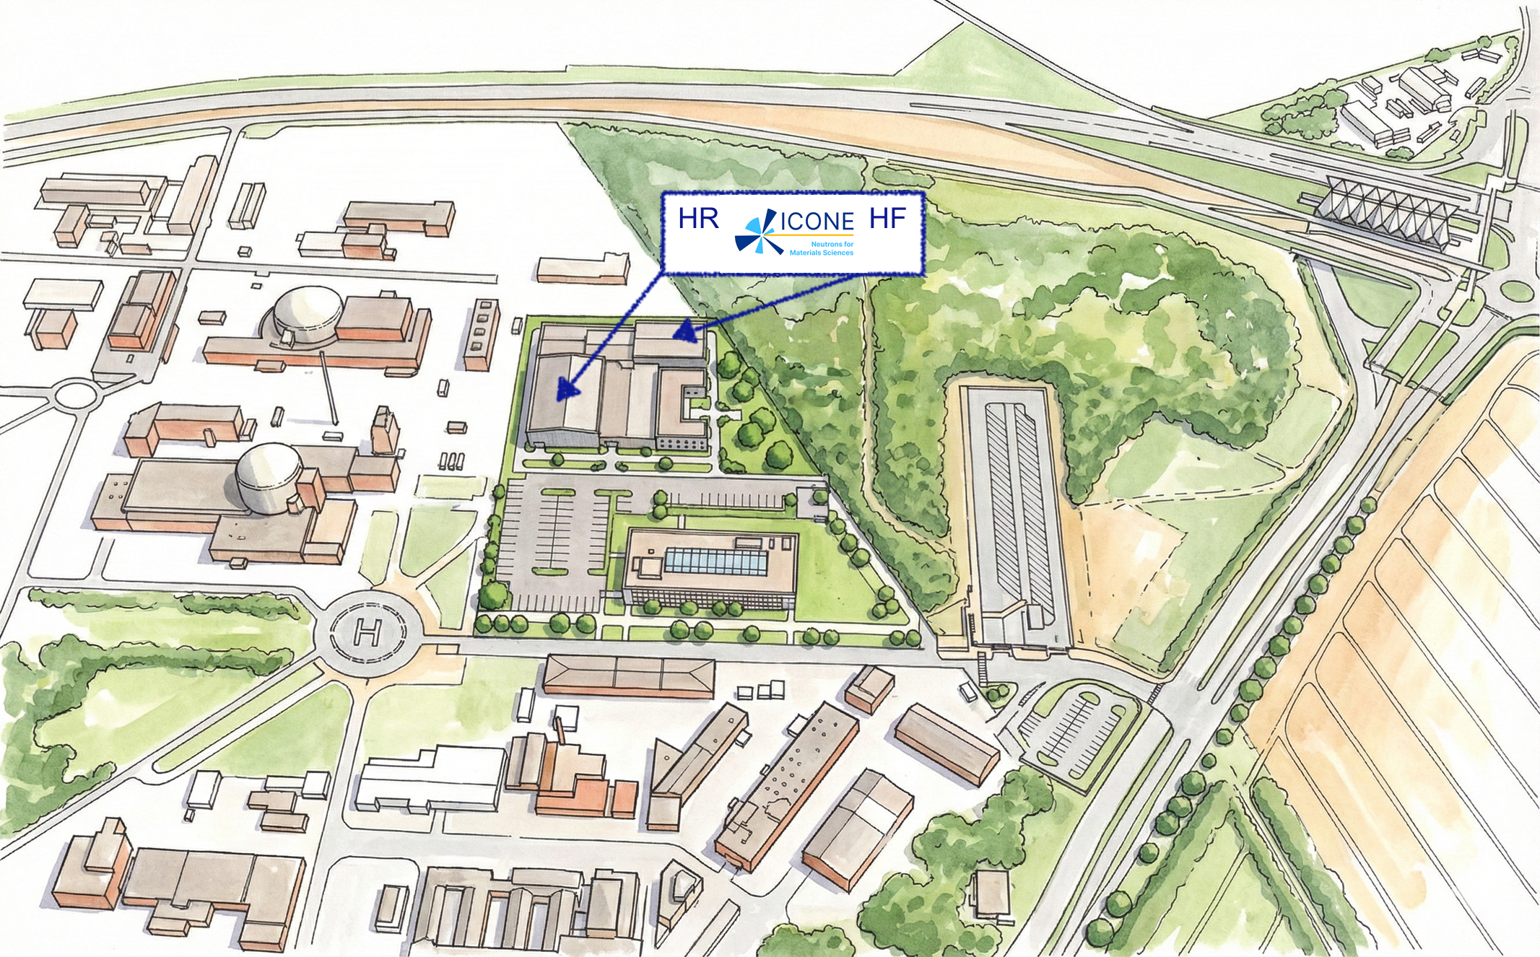
Artist’s rendering
Courtesy : X. Fabrèges
7
26/11/2025 – MLZ/LLB workshop – ICONE TDR results

Slide 8
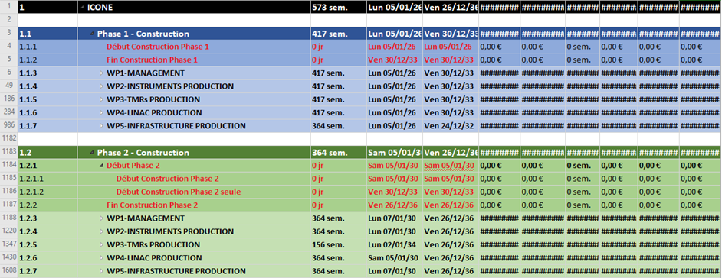
Construction planning
RBS - Requirements
From need to product…
PBS - Product
WBS - Work
…
to plan
8
26/11/2025 – MLZ/LLB workshop – ICONE TDR results

Slide 9
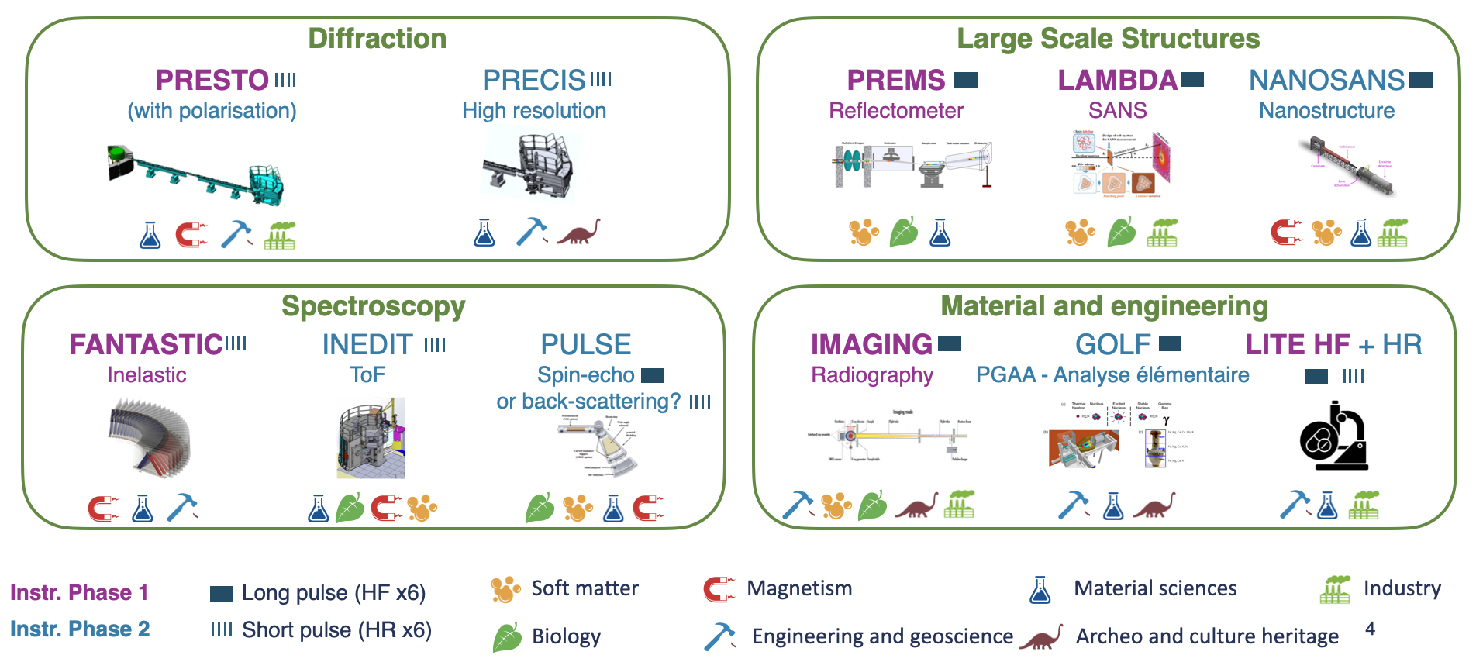
Scientific case (WP1)
→ Specifications for expected performances and for instruments
9
26/11/2025 – MLZ/LLB workshop – ICONE TDR results

Slide 10
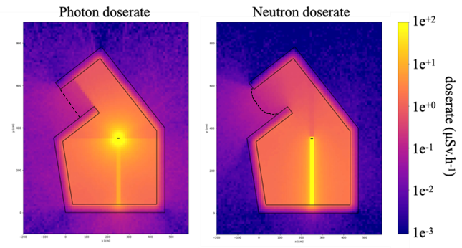
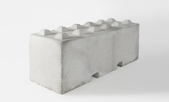
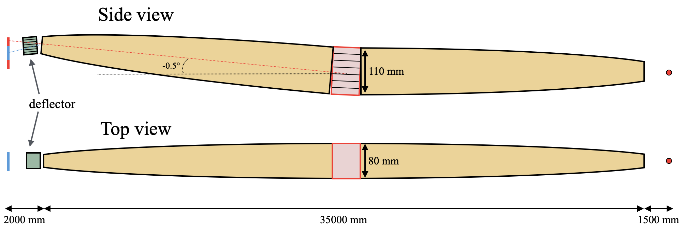
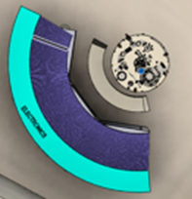
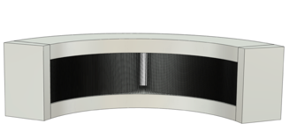
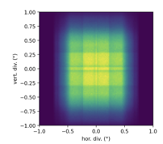
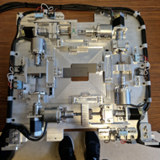
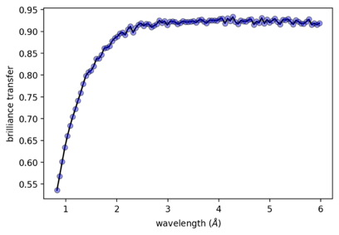
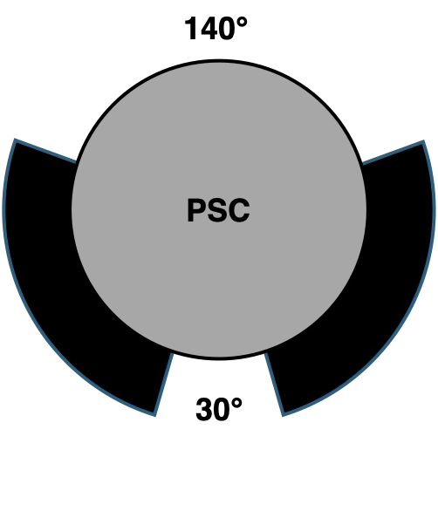
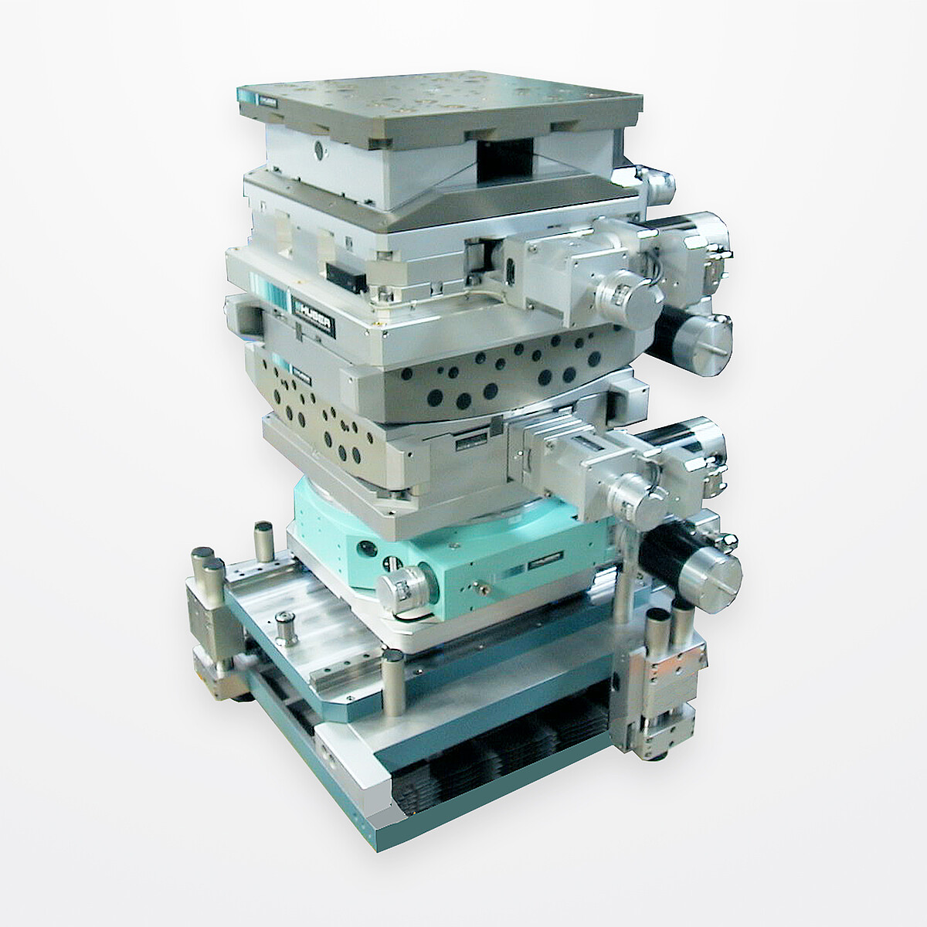
Instruments (WP2)
Radioprotection studies
Radiological protections
Experimental area
TMR Set
Neutrons
Transport
Useful
Neutrons
Sample
Efficient
Neutrons
Detection
Signal
Processing
information
Science
Radioprotection
Preparation
Maintenance
Neutron guide design
Sample Irradition
Neutron analysis
Neutron detector
Slits
Experiment simulation
Neutron guide transmission
(data processing incl.)
Choppers
Sample environnement
10
26/11/2025 – MLZ/LLB workshop – ICONE TDR results

Slide 11
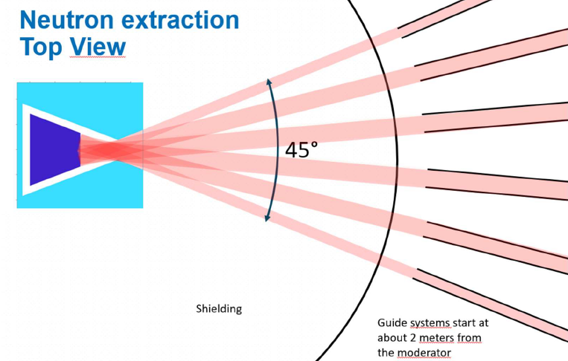
Target-Moderator-Reflector (WP3)
Reflector (not represented here) will be in Be
11
26/11/2025 – MLZ/LLB workshop – ICONE TDR results

Slide 12
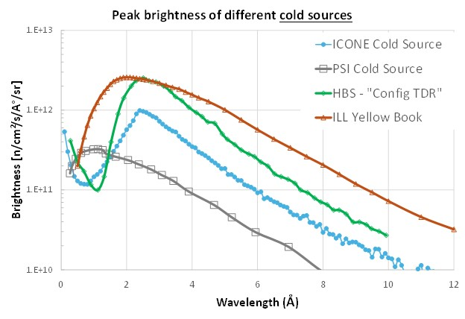
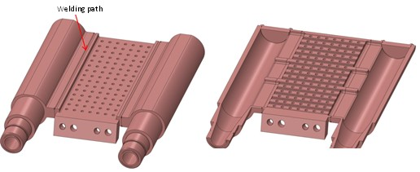
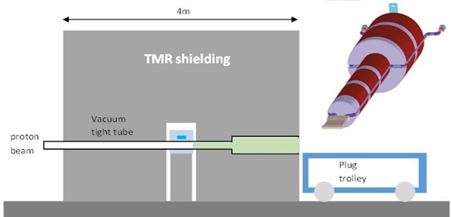
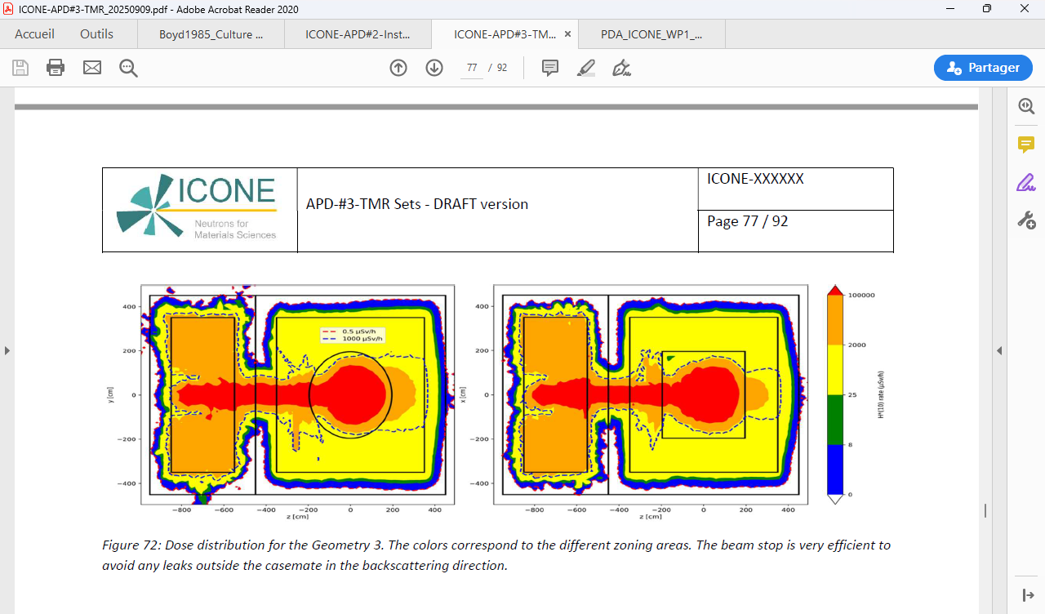
Target-Moderator-Reflector (WP3)
Target support prototype:
Mechanical tests and
Performances: Peak brightness (cold) between ILL and PSI
Radio-protection: monolithe + bunker
Dose rate : 10¹² µSv/h → <0.5 µSv/h
10⁵
2 10³
Protons
Dose rate [µSv/h]
Neutrons and gammas
25
8
< 0.5 µSv/h
12
26/11/2025 – MLZ/LLB workshop – ICONE TDR results

Slide 13
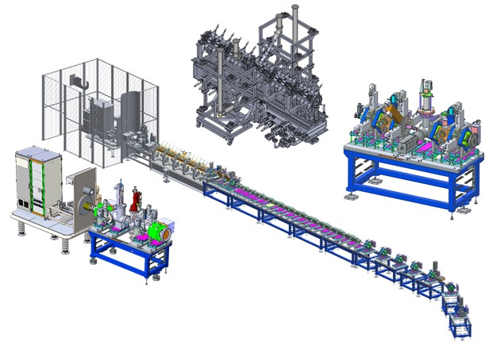
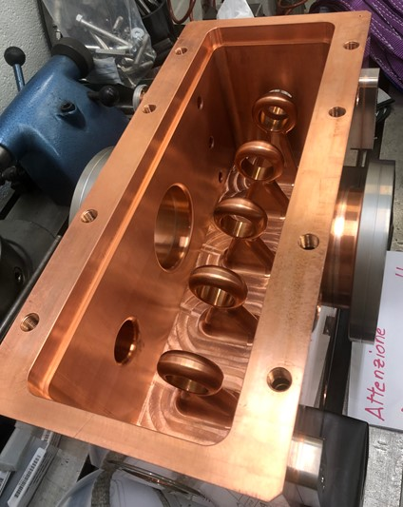
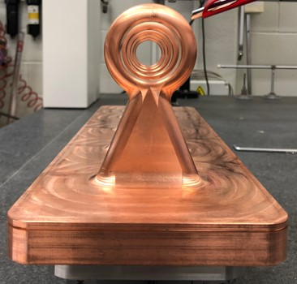
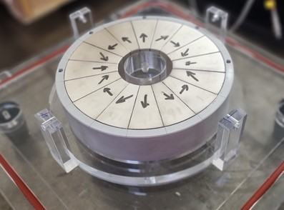
Linac (WP4)
RFQ
Design 3D:
Cavity Proto: built, tests in 2026
MEBT
LEBT
Qpole Proto: built, tests in 2026
13
26/11/2025 – MLZ/LLB workshop – ICONE TDR results

Slide 14
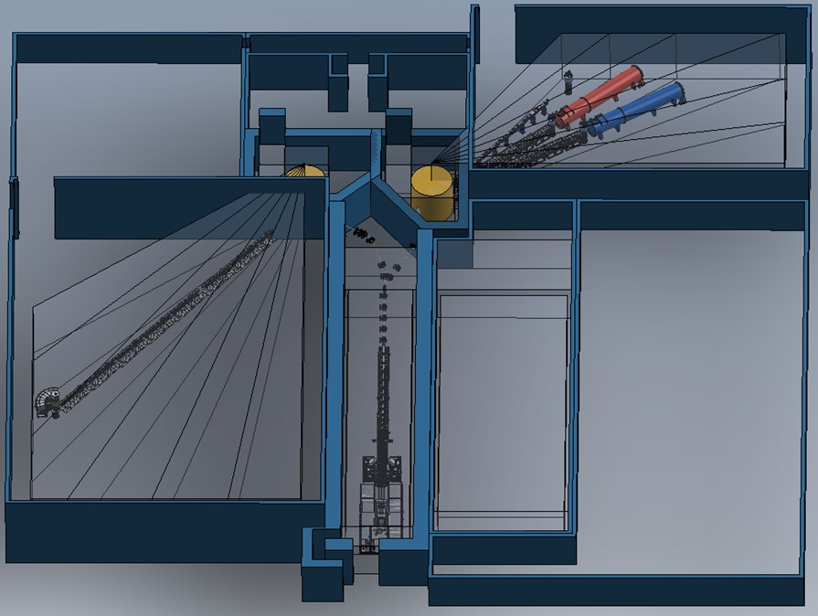
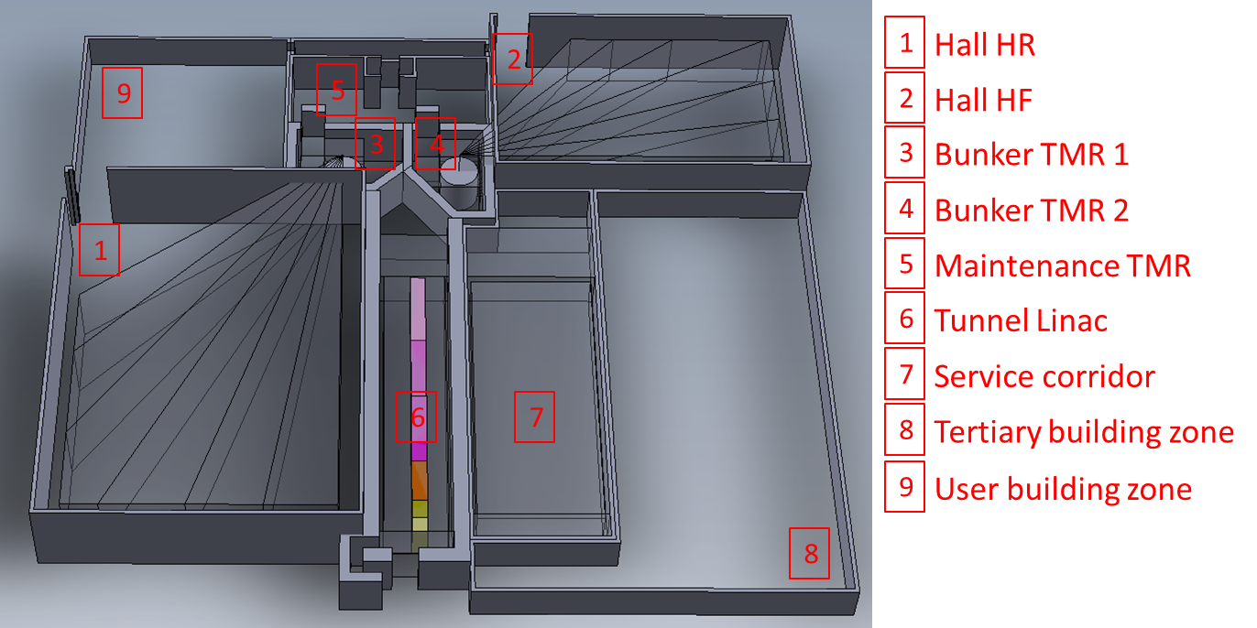
Infrastructure (WP5)
2
9
5
3
4
6
7
RF hall
Office area
1
Technical area
8
14
26/11/2025 – MLZ/LLB workshop – ICONE TDR results

Slide 15
Schedule
15
26/11/2025 – MLZ/LLB workshop – ICONE TDR results

Slide 16
Conclusion
Most elements are now designed.
We are ready to start the construction of elements on project critical path :
- RFQ.
- Infrastructure.
Some optimizations and engineering details of non-time-critical elements still have to be completed.
Budget situation is not yet fully stabilized.
16
26/11/2025 – MLZ/LLB workshop – ICONE TDR results

